Slide 1
Deep learning reveals predictive sequence concepts within immune repertoires to immunotherapy
John-William Sidhom, MD., PhD.
Giacomo Oliveira, PhD., Petra Ross-MacDonald, PhD., Megan Wind-Rotolo, PhD.,
Catherine J. Wu, MD., Drew M. Pardoll, MD., PhD., Alexander S. Baras, MD., PhD.

Slide 2
TCR sequencing
By studying the T-cell response through TCR-sequencing, one can characterize the antigenic determinants of response.
However, much of the work in cancer immunology has been limited to characterizing the quantitative aspects of the TCR repertoire.
Here, for the first time, we queried whether there are TCR sequence concepts (i.e. motifs) that were predictive of response to immunotherapy in melanoma.

Slide 3
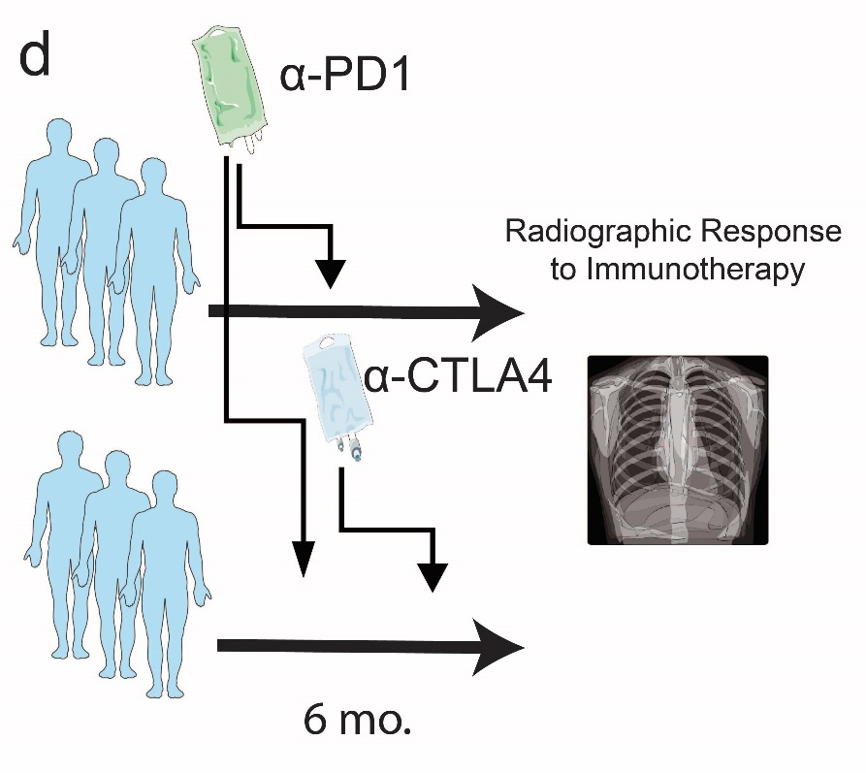
Checkmate-038
43 ptx w/TCR-Seq Pre & On Therapy

Slide 4
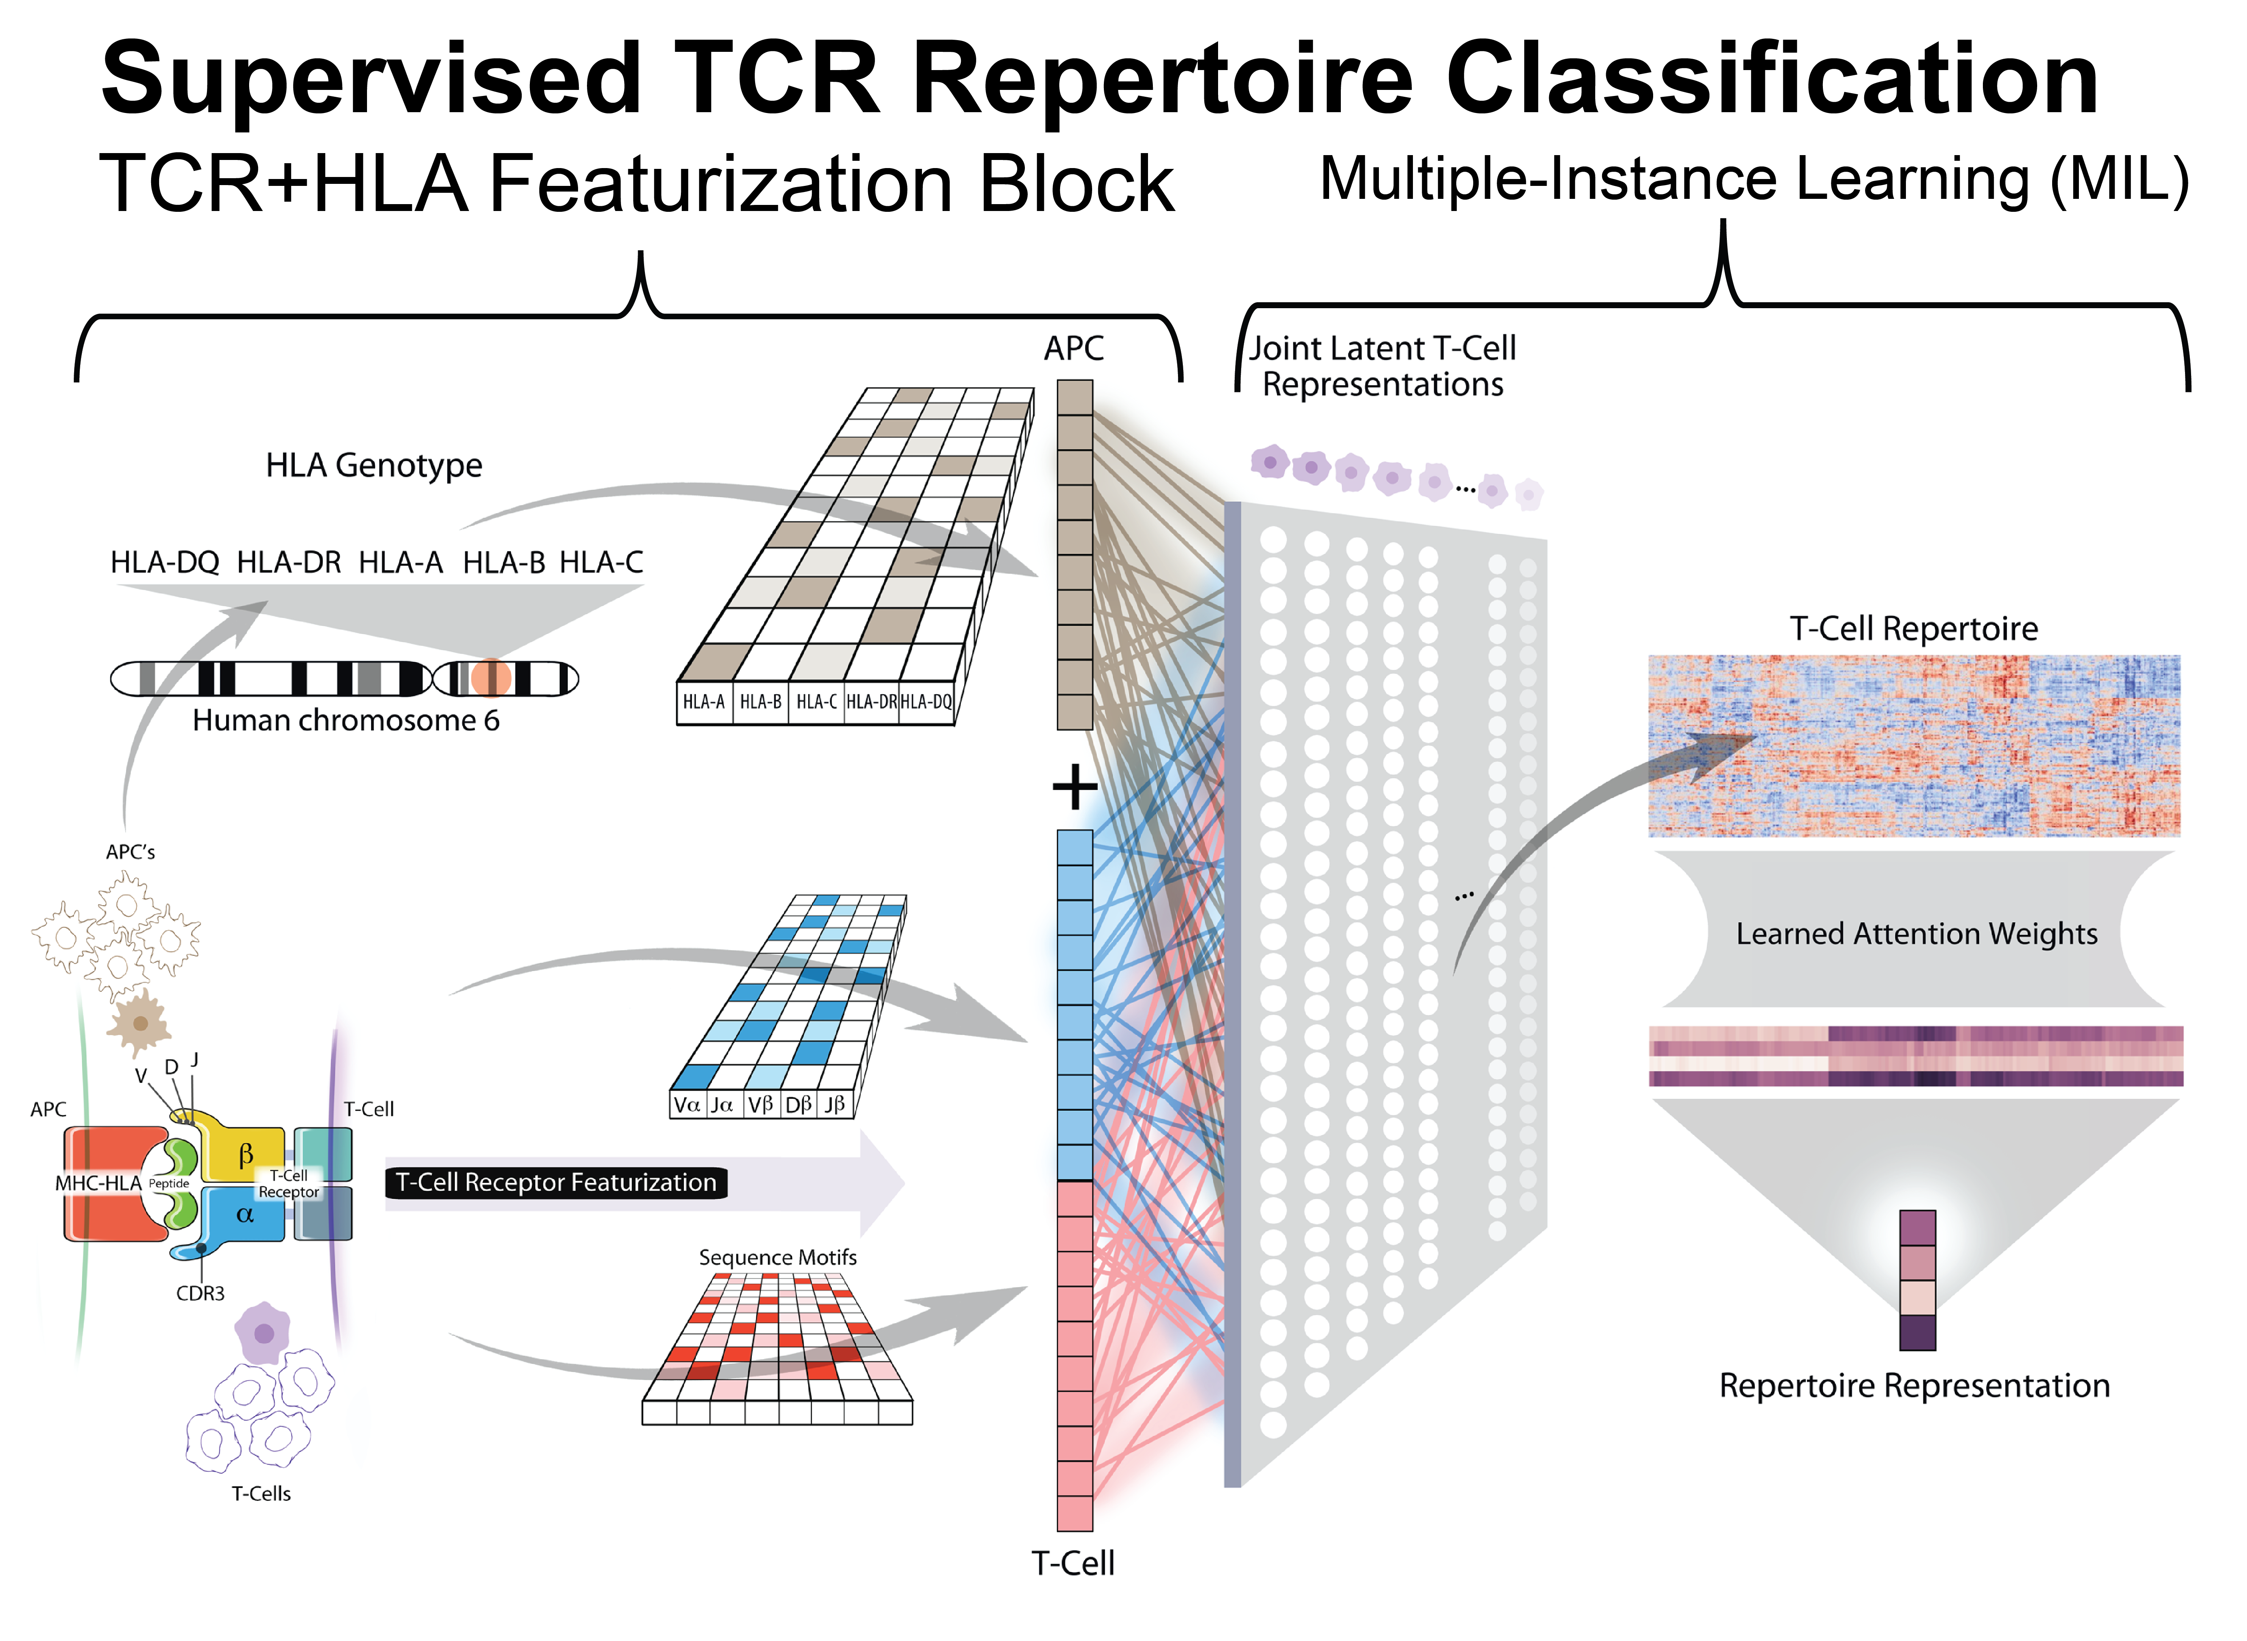
DeepTCR
Sidhom, J. W., et. al. Nature Communications (2021)

Slide 5
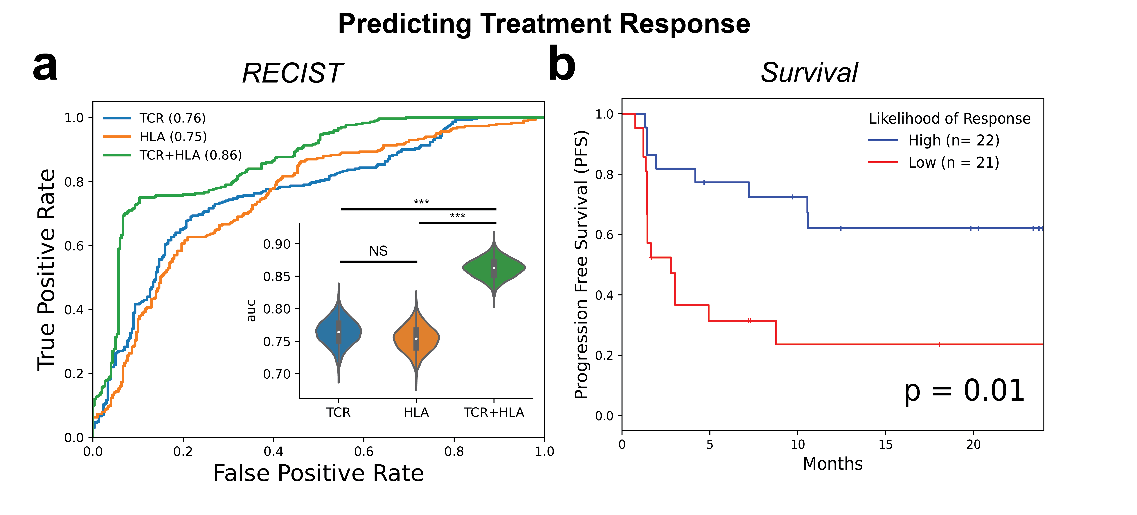
Predicting Response

Slide 6
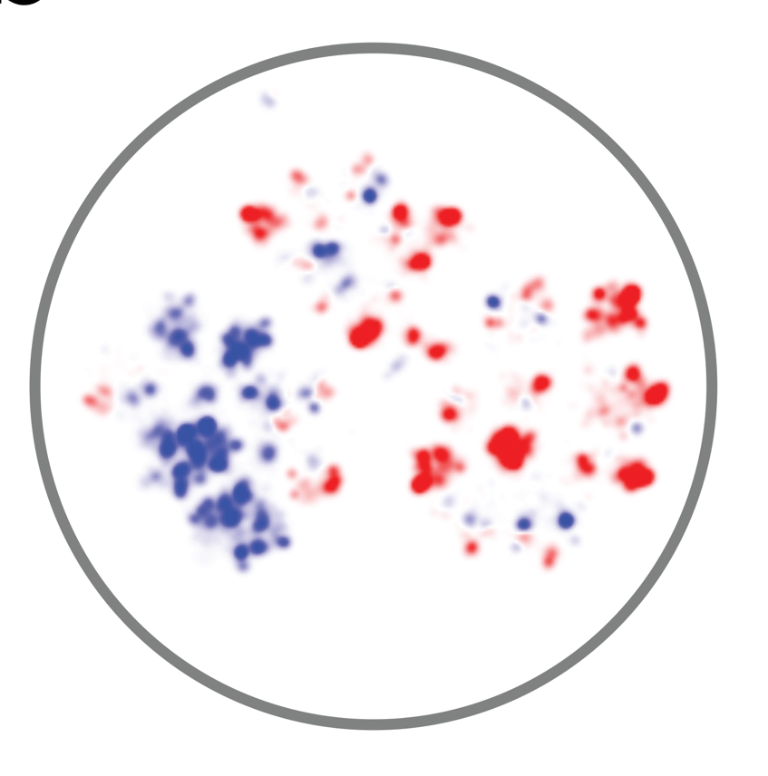
Blue = high P(response)
Red = low P(response)
Notes:
One umap of the cohort, quantitative measure of diversity between NR and R.

Slide 7
What are the specificities of these predictive TCRs?

Slide 8
Oliveira, G., et. al. Nature (2021)
P(response)
Giacomo Oliveira
Tumor specific
Virus specific
Notes:
One color gradient for umap.

Slide 9
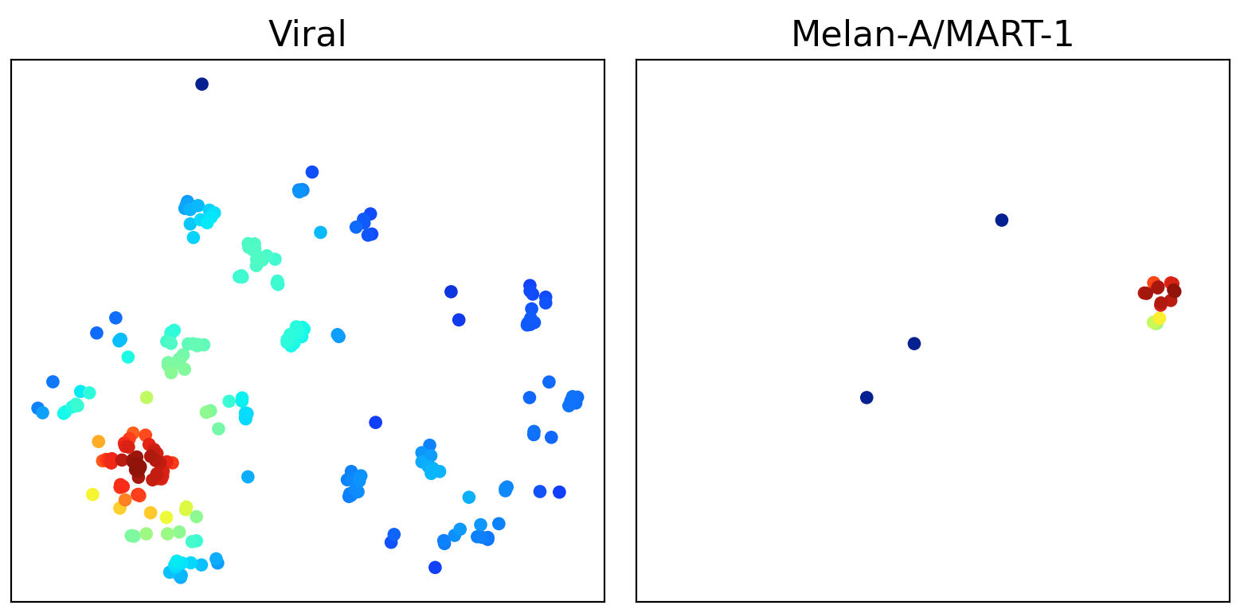
McPas DB Validation

Slide 10
