Slide 1
DeepTCR: A Deep Learning Framework For Revealing Structural Concepts within TCR Repertoire
John-William Sidhom, MD.,PhD. Candidate
Drew M. Pardoll, MD.,PhD.
Alexander S. Baras, MD.,PhD.

Slide 2
No Disclosures

Slide 3
T-Cell Receptor Sequencing
Count-based NGS method of CDR3
Quantitative assessment of T-Cell repertoire
Sequence acts as ‘barcode’

Slide 4
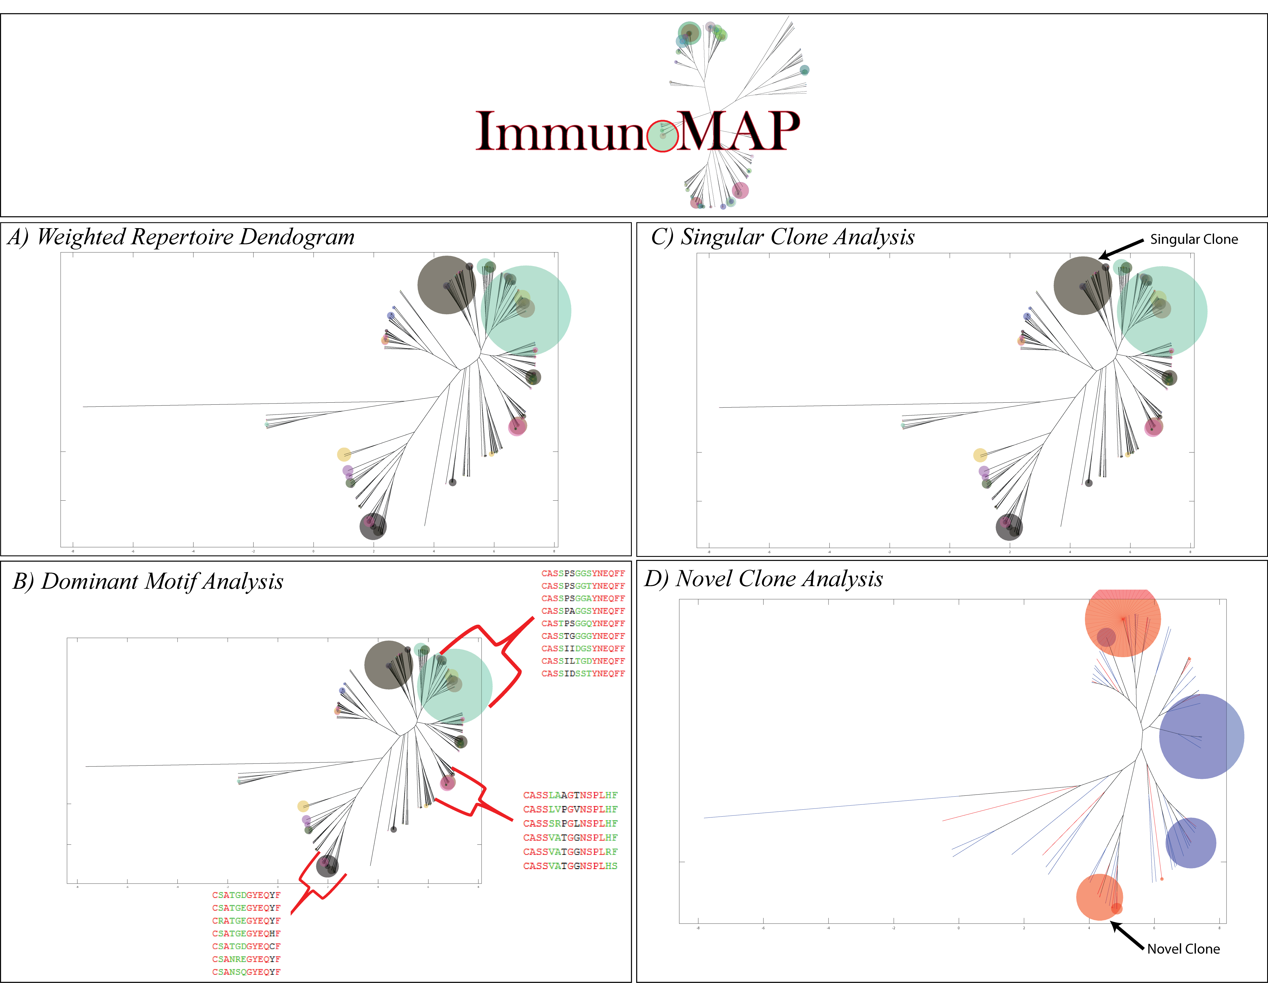
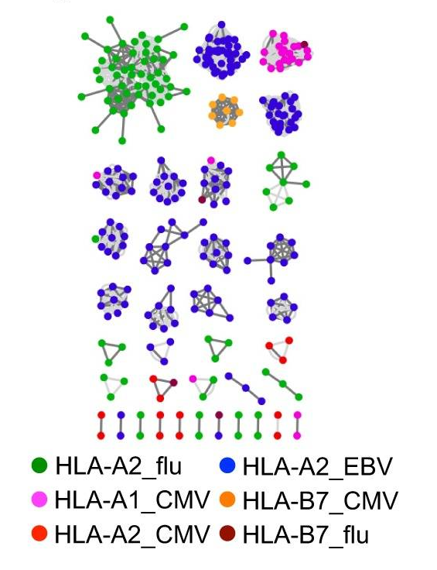
Current Structural Approaches
GLIPH¹
ImmunoMap²
¹Glanville, J., Huang, H., Nau, A., Hatton, O., Wagar, L. E., Rubelt, F., ... & Haas, N. (2017). Identifying specificity groups in the T cell receptor repertoire. Nature, 547(7661), 94.
²Sidhom, J. W., Bessell, C. A., Havel, J. J., Kosmides, A., Chan, T. A., & Schneck, J. P. (2018). ImmunoMap: A Bioinformatics Tool for T-cell Repertoire Analysis. Cancer immunology research, 6(2), 151-162

Slide 5
DeepTCR
Unsupervised and Supervised Deep Learning Methods to Parse TCRSeq
Unsupervised Methods:
Uncovering structure in data when labels are not provided
Clustering Homologous Sequences
Structurally Comparing Whole Repertoires/Samples
Supervised Methods:
Using labeled data to guide training process.
Discovering predictive structural signatures in the data

Slide 6
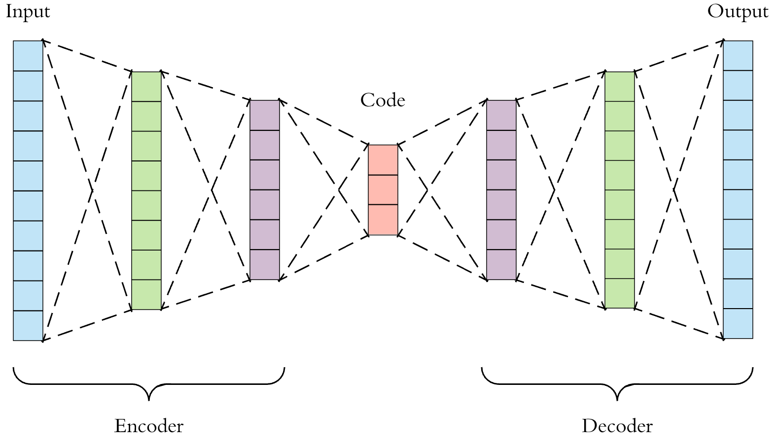
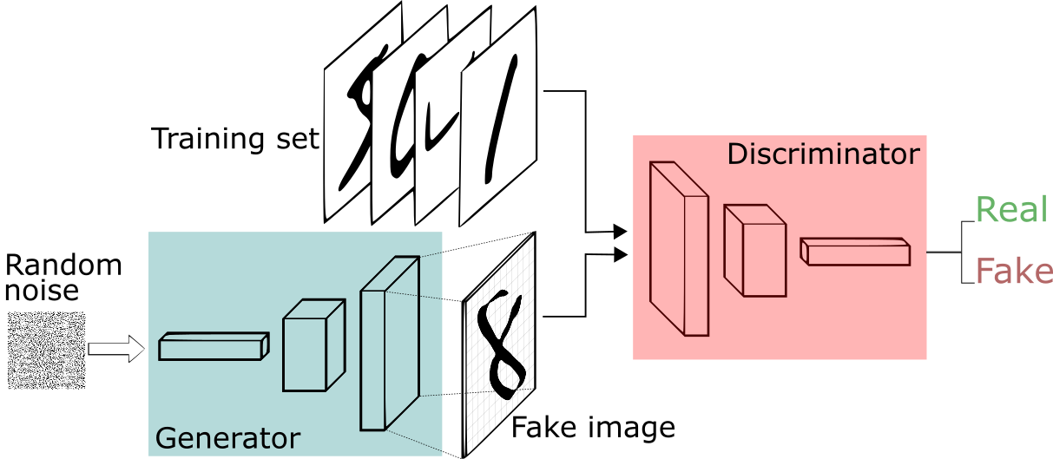
Unsupervised Methods
Variational Autoencoder (VAE)
Generative Adversarial Network (GAN)

Slide 7
Benchmarking against GLIPH
Glanville, J., Huang, H., Nau, A., Hatton, O., Wagar, L. E., Rubelt, F., ... & Haas, N. (2017). Identifying specificity groups in the T cell receptor repertoire. Nature, 547(7661), 94.

Slide 8
Wholistic Structural Analysis
SIY/TRP2
Sequences-by-Features
Samples-by-Features
Sidhom, J. W., Bessell, C. A., Havel, J. J., Kosmides, A., Chan, T. A., & Schneck, J. P. (2018). ImmunoMap: A Bioinformatics Tool for T-cell Repertoire Analysis. Cancer immunology research, 6(2), 151-162

Slide 9
Key Advantages
Uses TensorFlow that can take advantage of GPU’s, thus able to process millions of TCR sequences within seconds.
Requires only β-chain sequence.
Structural comparisons of whole repertoires, not just sequences

Slide 10
Supervised Methods

Slide 11
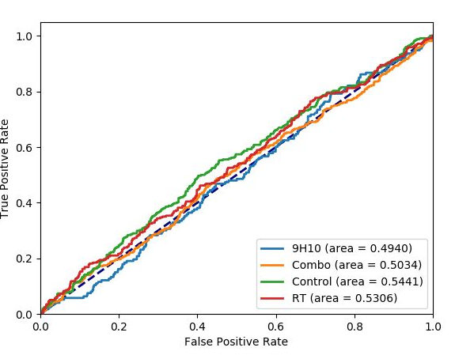
TIL Repertoire - Immunotherapy
Single-Sequence Classifier
Whole Sample Classifier
Rudqvist, N. P., Pilones, K. A., Lhuillier, C., Wennerberg, E., Sidhom, J. W., Emerson, R. O., ... & Demaria, S. (2018). Radiotherapy and CTLA-4 blockade shape the TCR repertoire of tumor-infiltrating T cells. Cancer Immunol Res, 6, 139-50.

Slide 12
‘Explainability’ of Neural Networks

Slide 13
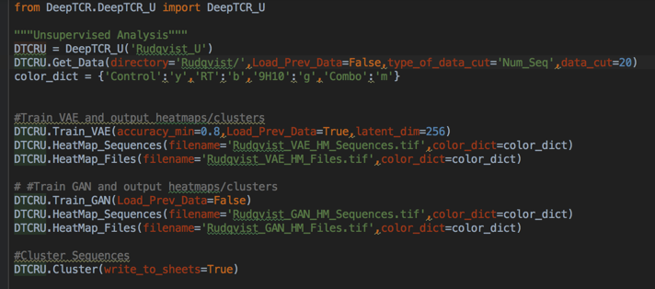
How can you use DeepTCR?
Pre-Print @ Biorxiv
Python Package & Github Repository
https://github.com/sidhomj/DeepTCR
Source Code/Easy Install Instructions
Jupyter Notebook Tutorial
Questions?
jsidhom1@jhmi.edu
Poster: P588

