Slide 2
A Novel Bioinformatics Tool for Immune Cell Repertoire Analysis
^{John-William Sidhom}
^{MD/PhD Candidate MII,GIII}
^{Jonathan Schneck Lab}
Poster: 112

Slide 3
Presenter Disclosure Information
John-William Sidhom
The following relationships exist related to this presentation:
No relationships to disclose

Slide 4
Overview
Algorithm Overview
Basic Science Application
Understanding Antigen-Specific Responses in Naïve and Tumor-Bearing Setting
Clinical/Translational Application
Revealing signatures associated with responders on checkpoint blockade
Poster: 112

Slide 5
Background
Advent of sequencing of T Cell Receptor CDR3
Understanding Immune Responses to Cancer
BIG DATA
Clones
Frequency (Reads)
V,D,J usage
Difficult to parse data into meaningful biological conclusions
Poster: 112

Slide 6
Current Approaches
Diversity of Individual Repertoire
Shannon Entropy – measure of diversity as a function of # of sequences & frequency¹
Comparing Multiple Repertoires
Tracking exact clonotypes (at nucleotide or amino acid level)^{2,3}
Ignore Sequence Relatedness & Structure
Poster: 112

Slide 7
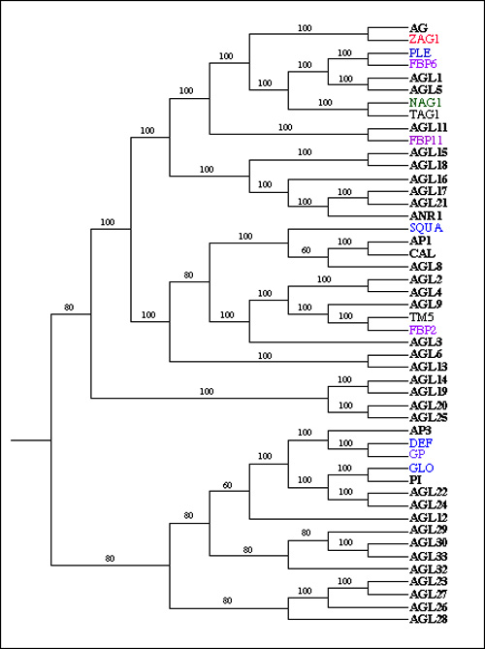
Phylogenetic Approach
Evolutionary Biology Approach
Phylogenetic ‘distance’ can be used to understand how a collection of sequences is related to itself and other samples
Function of Sequence Alignment Scores
EBV
SIY
SIY
SIY
Phylogenetic Distance
0.2481
0.9884
Poster: 112

Slide 8
Overview of…
Weighted Phylogenetic Trees
Sequencing Data
(Sequence, Frequency, VDJ Usage)
Dominant Motif Analysis
TCR Diversity Score
Poster: 112

Slide 9
Weighted Phylogenetic Trees
Color of Circle: V-Beta Usage
Size of Circle: Frequency of Sequence
Poster: 112

Slide 10
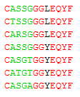
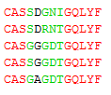
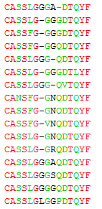
Dominant Motif Analysis
Clusters of sequences based on phylogenetic distance and frequency selected and termed, ‘Dominant Motifs’
Color of Circle: V-Beta Usage
Size of Circle: Frequency of Sequence
Poster: 112

Slide 11
TCR Diversity Score
Score = average phylogenetic distance of all sequences in a sample.
Score ranges from 0 to 1
1 = All Sequences Identical
0 = All Sequences Infinitely Different
0.2076
0.9600
Poster: 112

Slide 12
Antigen-Specific Responses in Naïve and Tumor-Bearing Settings
Tumor-Bearing
Naive
Kb-SIY: Foreign Antigen
Kb-TRP2: Self Antigen
Poster: 112

Slide 13
Weighted Phylogenetic Trees – Naïve
Color of Circle: V-Beta Usage
Size of Circle: Frequency of Sequence
Poster: 112

Slide 14
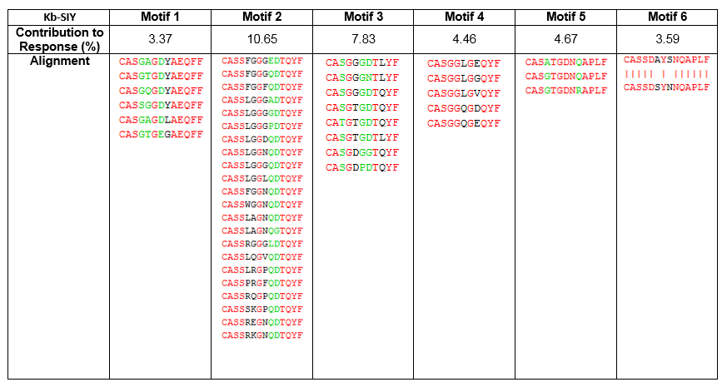
Dominant Motif Analysis – Naïve
SIY
TRP2
Poster: 112

Slide 15
Weighted Phylogenetic Trees – Tumor-Bearing
SIY
TRP2
Blue: Naïve Response
Red: Tumor-Bearing Response
Poster: 112

Slide 16
Dominant Motif Analysis – Tumor-Bearing
SIY
TRP2
Poster: 112

Slide 17
Analysis of Tumor-Infiltrating Lymphocytes from Melanoma Pts. Undergoing α-PD1
Poster: 112

Slide 18
Concluding Points
Current approaches to TCR Repertoire Analysis do not address structural/sequence aspects of the response
ImmunoMAP uses a novel phylogenetic approach to understand repertoire structure and diversity
Insights from ImmunoMAP to:
Understand the basic biology of immune responses across many scientific and medical fields (oncology, autoimmunity, infectious disease)
Differential immune pressure on various tumor antigens
Characterize responses of patients who respond/resist immune therapies
Poster: 112

Slide 19
Acknowledgements
Dr. Jonathan Schneck’s Lab
Catherine Ami Bessell
Kristy Chu
Alyssa Kosmides
John Hickey
Bo-yi
Dr. Timothy Chan’s Lab
Jonathan Havel
Poster: 112

Slide 20
References
Jost, L. PARTITIONING DIVERSITY INTO INDEPENDENT ALPHA AND BETA COMPONENTS. Ecology 88, 2427–2439 (2007).
Sherwood, A. et al. Tumor-infiltrating lymphocytes in colorectal tumors display a diversity of T cell receptor sequences that differ from the T cells in adjacent mucosal tissue. Cancer Immunol Immunother 62, 1453–61 (2013).
Venturi, V, Kedzierska, K, Tanaka, MM & Turner, SJ. Method for assessing the similarity between subsets of the T cell receptor repertoire. Journal of … (2008). doi:10.1016/j.jim.2007.09.016

