Slide 1
Deep Learning of the Immune Synapse
John-William Sidhom, MD.,PhD. Candidate
Drew Pardoll, MD.,PhD.
Alexander Baras, MD.,PhD.

Slide 2
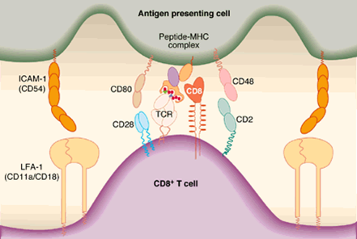
The Immune Synapse
https://med.nyu.edu/skirball-lab/stokeslab/tcell.html

Slide 3
T-Cell Receptor Sequencing
Count-based NGS method of CDR3
Quantitative assessment of T-Cell repertoire
Sequence acts as ‘barcode’

Slide 4
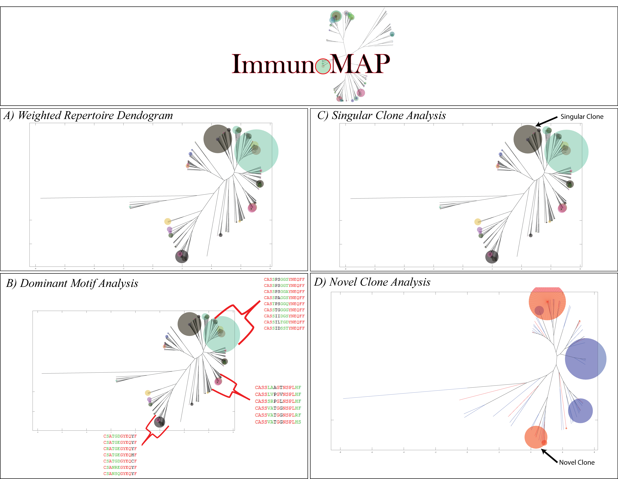
Current Analytical Approaches
Tracking clones at nucleotide/amino-acid level
Structural Algorithms
GLIPH¹
ImmunoMap²
¹Glanville, J., Huang, H., Nau, A., Hatton, O., Wagar, L. E., Rubelt, F., ... & Haas, N. (2017). Identifying specificity groups in the T cell receptor repertoire. Nature, 547(7661), 94.
²Sidhom, J. W., Bessell, C. A., Havel, J. J., Kosmides, A., Chan, T. A., & Schneck, J. P. (2018). ImmunoMap: A Bioinformatics Tool for T-cell Repertoire Analysis. Cancer immunology research, 6(2), 151-162

Slide 5
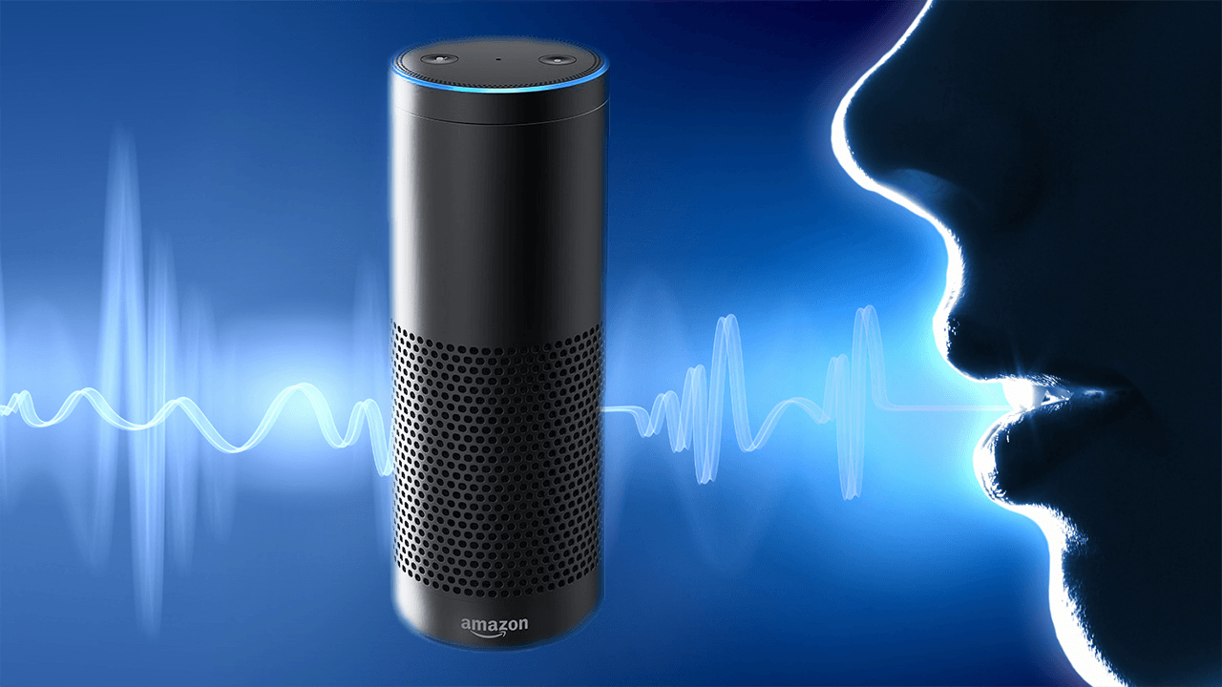
Deep Learning
Deep Learning has shined in areas of pattern recognition, achieving state-of-the-art performance in many fields.
Voice recognition/semantics
Image classification
Universal Function Approximators
Flexibility
High capacity
Domain-specific knowledge not needed (for better or for worse)
Active area of research in ML/AI community
Ideas are spread quickly and adopted easily
Novelty
Open space for innovation

Slide 6
CNN’s for Biological Sequence Analysis
One can convolve across sequences to learn features/motifs that can be used to infer something about the sequence.
DeepBind – learning specificities of DNA/RNA-binding proteins
Alipanahi, B., Delong, A., Weirauch, M. T., & Frey, B. J. (2015). Predicting the sequence specificities of DNA-and RNA-binding proteins by deep learning. Nature biotechnology, 33(8), 831.

Slide 7
DeepTCR
Unsupervised and Supervised Deep Learning Methods to Parse TCRSeq
Unsupervised Methods:
Variational Autoencoder (VAE)
Generative Adversarial Network (GAN)
Supervised Methods:
Single Sequence Classification
Whole Sample Classification

Slide 8
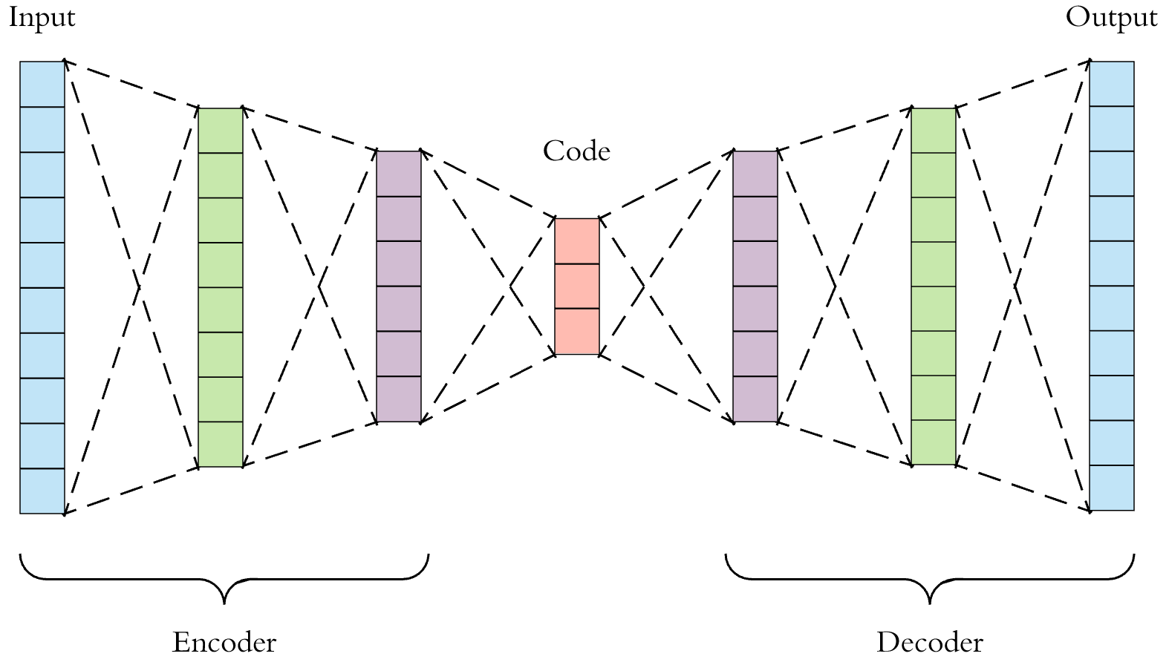
Variational Autoencoder
Autoencoder
Dimensionality reduction technique.
Popular choice for learning latent representations of image data.
Objective Function: Reconstruction of the input data
Variational Autoencoder
Secondary Objective Function:
Min(KL(N(μ(X),σ(X)) || N(O,I))
Problem: Reconstruction loss encourages network to learn length-dependent features.

Slide 9
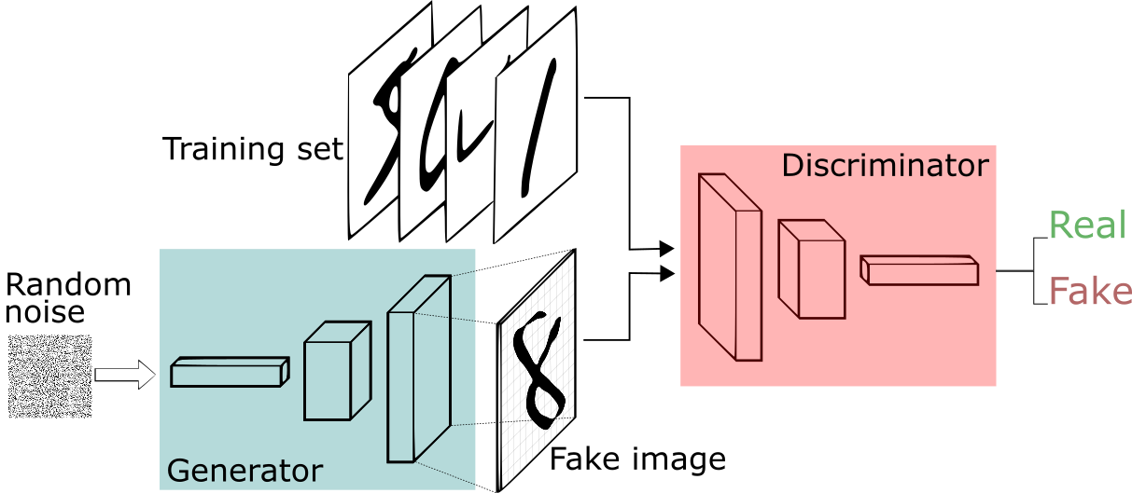
Generative Adversarial Network
Train two networks (discriminator vs generator).
Generator: attempts to mimic sequences from the true distribution of sequences
Discriminator: attempts to discriminate true sequences from distribution from ‘fake’ generated sequences from generator.
One can use the last layer of the discriminator as a ‘latent’ layer on which to study the distribution of sequences.
Objective functions:
Generator: minimize the cross-entropy loss of classifying output of generator as ‘real’
Discriminator: minimize the cross-entropy loss of classifying real vs fake inputs
*** Does not attempt to reconstruct sequence

Slide 10
Benchmarking against GLIPH

Slide 11
Benchmarking against GLIPH

Slide 12
Supervised Methods

Slide 13
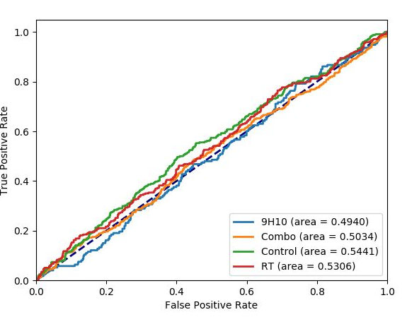
TIL Repertoire - Immunotherapy
Single-Sequence Classifier
Whole Sample Classifier
Rudqvist, N. P., Pilones, K. A., Lhuillier, C., Wennerberg, E., Sidhom, J. W., Emerson, R. O., ... & Demaria, S. (2018). Radiotherapy and CTLA-4 blockade shape the TCR repertoire of tumor-infiltrating T cells. Cancer Immunol Res, 6, 139-50.

Slide 14
‘Explainability’ of Neural Networks

Slide 15
Conclusion
Deep Learning has revolutionized many fields and has been the most influential form of AI.
Preliminary applications of deep learning in the medical field include digital pathology and radiology.
The same technology used to recognize features in images can be translated to studying the immune synapse in order to understand its complex nature.
Poster 20S

Slide 16
Acknowledgments
Thesis Committee
Drew Pardoll, MD., PhD.
Alexander Baras, MD., PhD.
Steven Salzberg, PhD.

