Slide 1
Deep Learning for Distinguishing Morphological Features of Acute Promyelocytic Leukemia
John-William Sidhom, MD/PhD Candidate ’21
Department of Biomedical Engineering
Johns Hopkins University School of Medicine
Ingharan J Siddarthan, Bo-Shiun Lai, Adam Luo, Bryan Hambley, Jennifer Bynum, Amy S. Duffield, Michael B. Streiff, Alison R. Moliterno, Philip H. Imus, Christian B. Gocke, Lukasz P. Gondek, Amy E. DeZern, Alexander S Baras, Thomas S. Kickler, Mark Levis, Eugene Shenderov
December 6, 2020
Sidney Kimmel Comprehensive Cancer Center
Johns Hopkins University

Slide 2
Disclosure
I have no financial disclosure or conflicts of interest with the presented material in this presentation.

Slide 3
APL
Acute Promyelocytic Leukemia (APL) is subtype of Acute Myeloid Leukemia (AML).
Defined by translocation - t(15;17)
Distinguished clinically by rapidly progressive and fatal course, often from disseminated intravascular coagulation (DIC).

Slide 4
Problem
Acute nature requires prompt recognition and initiation of life-saving All-transretinoic Acid (ATRA).
However, gold standard genetic tests (PCR, FISH) can often take days to confirm the diagnosis.
Therapy is often initiated on clinical suspicion.
  Aided by visualization of peripheral smear looking for pathognomonic Auer rods.

Slide 5
Hypothesis
Deep learning model could more accurately and quickly diagnose APL from peripheral smear, providing clinicians the diagnostic information needed to quickly identify and treat patients with APL.

Slide 6
Patient Population
Identified via retrospective chart review from a list of confirmed FISH t(15;17)-positive (n = 34) and -negative (n = 72) patients presenting at The Johns Hopkins Hospital (JHH).
Inclusion criteria included new disease diagnosis, no prior treatment, and availability of peripheral blood smear image uploaded to CellaVision.
Patients were separated into a discovery cohort presenting prior to 1/2019 (APL, n = 22; AML, n=60) and a validation cohort presenting on or after 1/2019 (APL, n = 12; AML, n = 12).

Slide 7
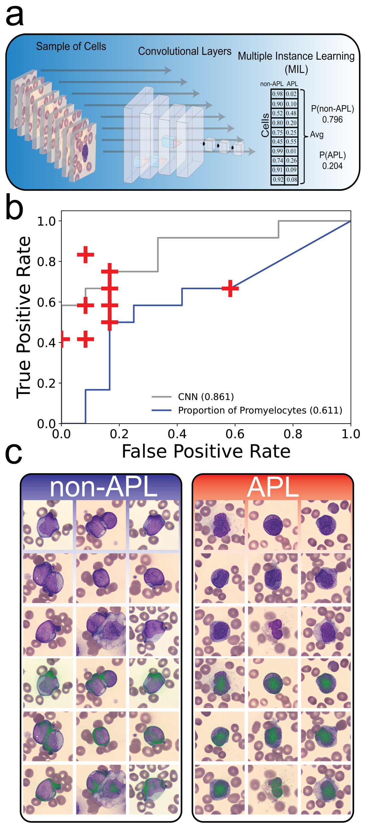
Deep Learning Model

Slide 8
Performance
10 academic oncologists were provided peripheral smears from the validation cohort and asked to identify APL patients.
Benchmarked against deep learning model as well as proportion of promyelocytes as determined by Cellavision algorithm.
+ Oncologists

Slide 9
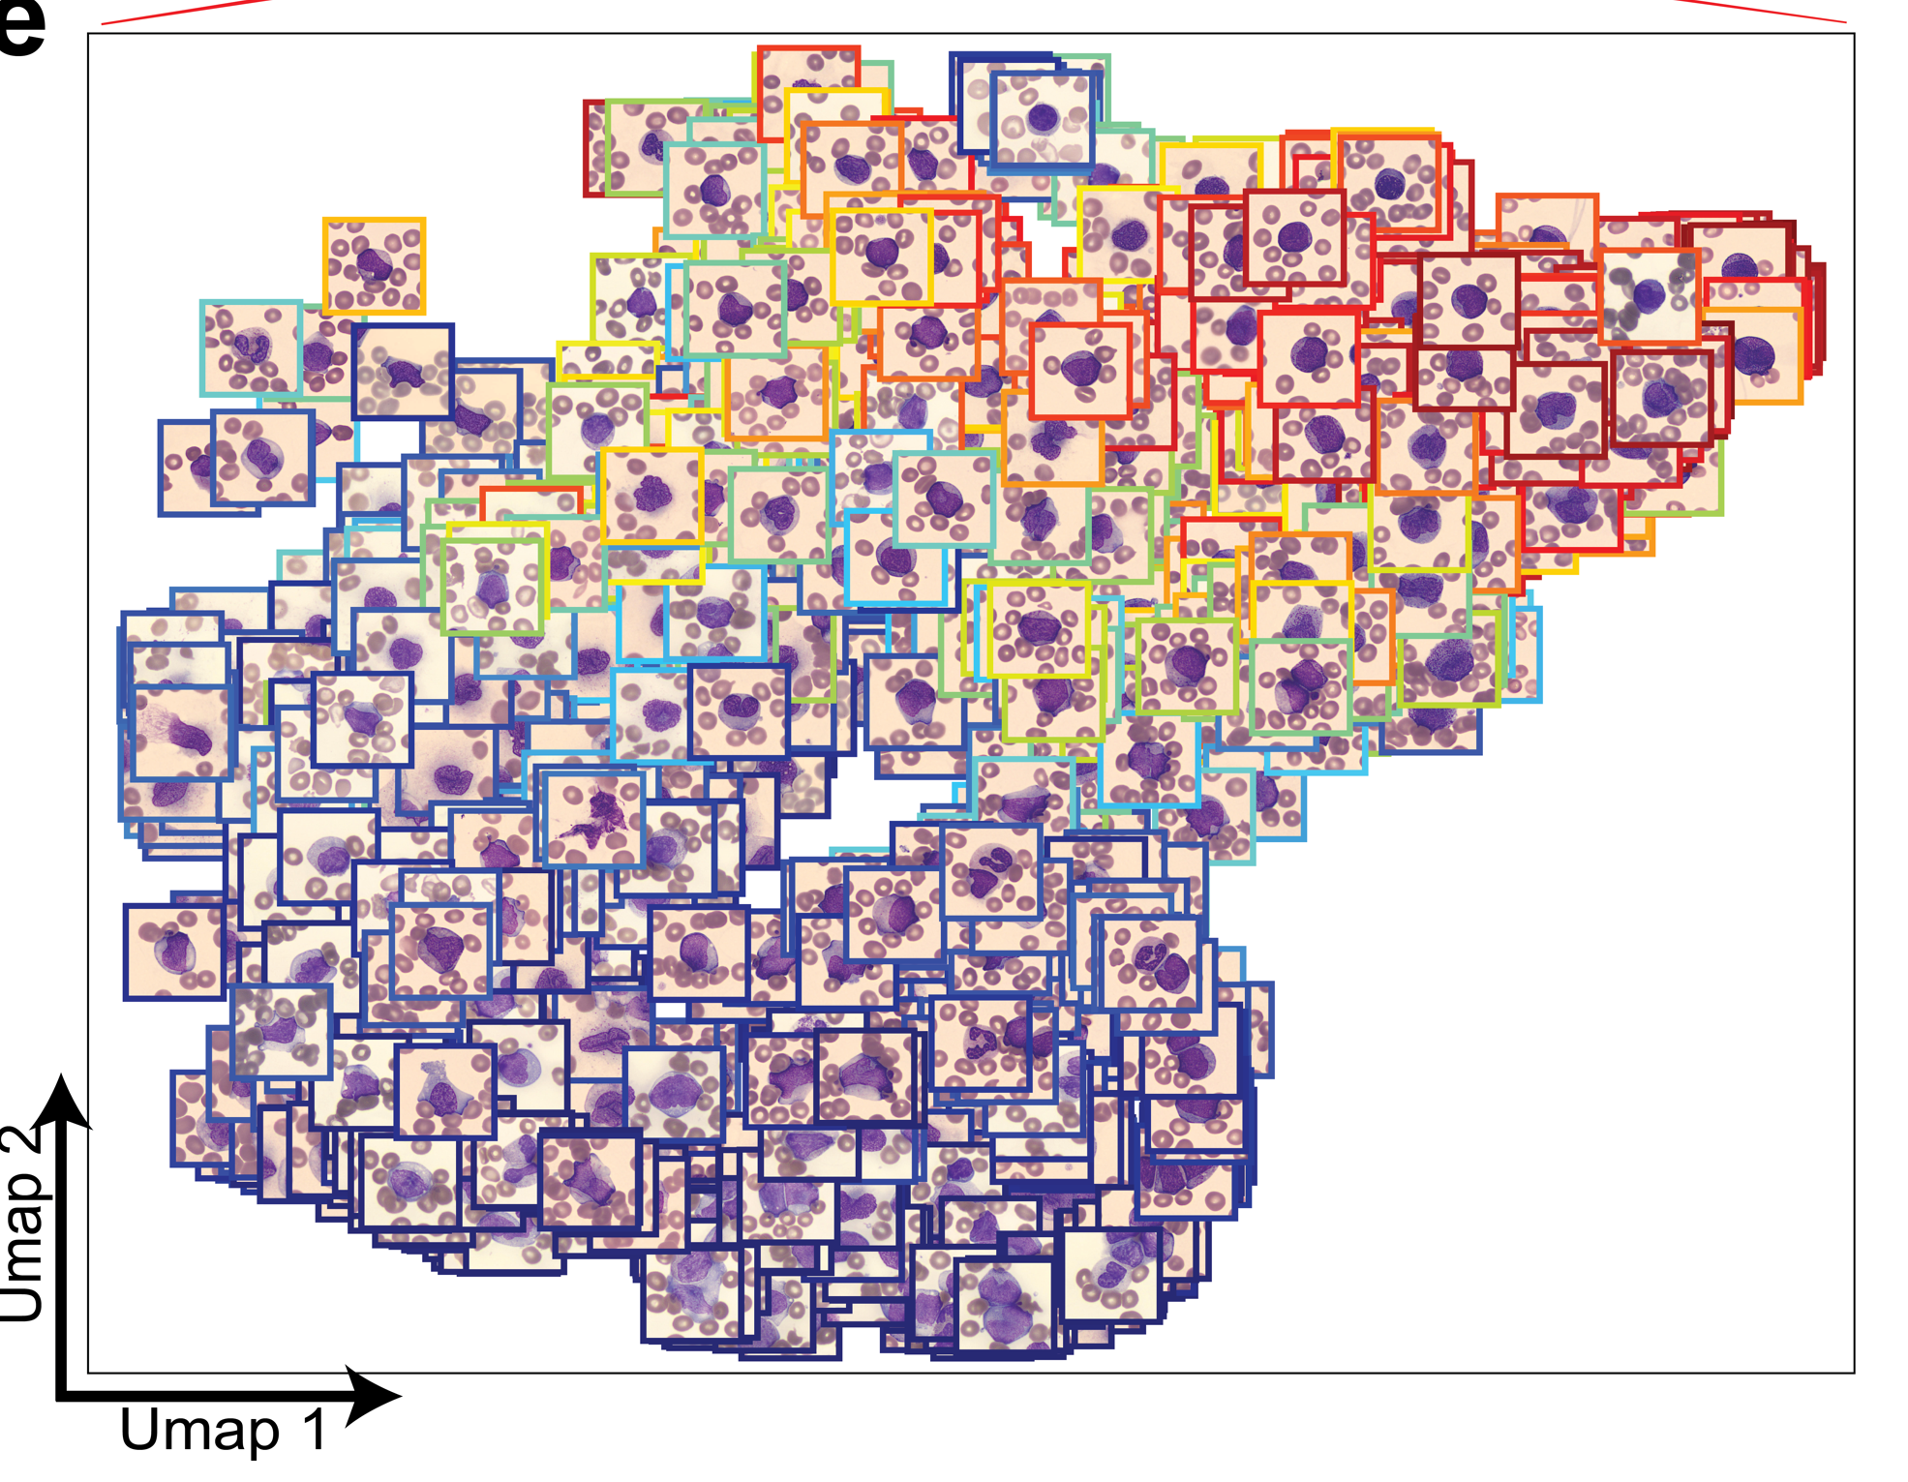
Explainable AI

Slide 10
Conclusion
Deep learning model capable of rapid and accurate diagnosis of APL from universally available peripheral smears.
Explainable artificial intelligence is provided for biological insights to facilitate clinical management and reveal morphological concepts previously unappreciated in APL.
The deep learning framework we have delineated is applicable to any diagnostic pipeline that can leverage a peripheral blood smear, potentially allowing for efficient diagnosis and early treatment of disease.

