Slide 1
DeepTCR: A Deep Learning Framework For Revealing Structural Concepts within TCR Repertoire
John-William Sidhom, MD.,PhD. Candidate
Drew M. Pardoll, MD.,PhD.
Alexander S. Baras, MD.,PhD.

Slide 2
T-Cell Receptor Sequencing
Count-based NGS method of CDR3
Used to answer questions of antigen-specificity in anti-tumor responses

Slide 3
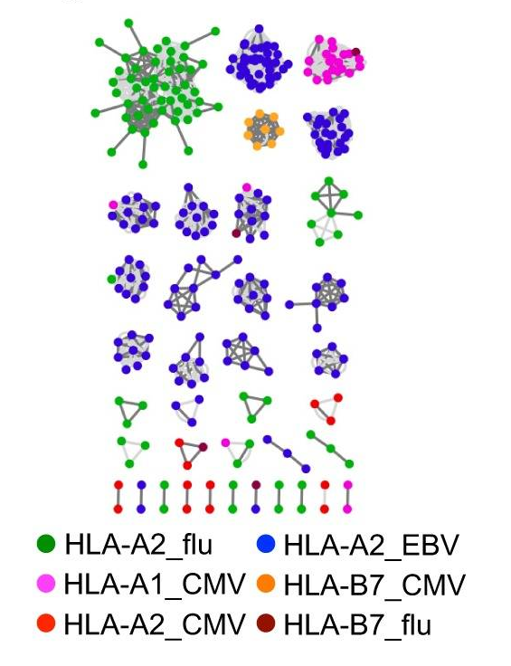
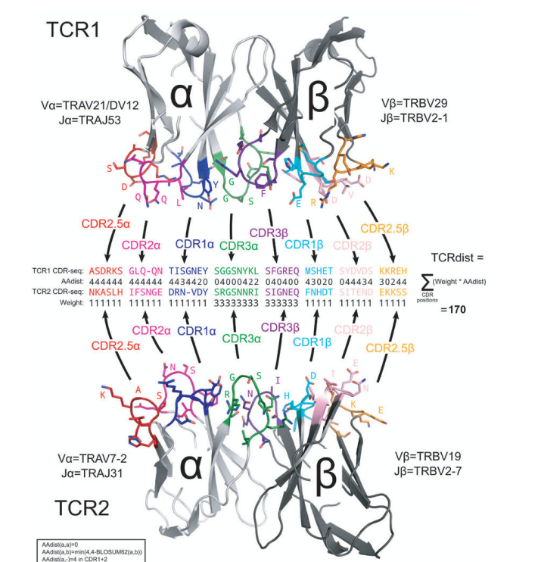
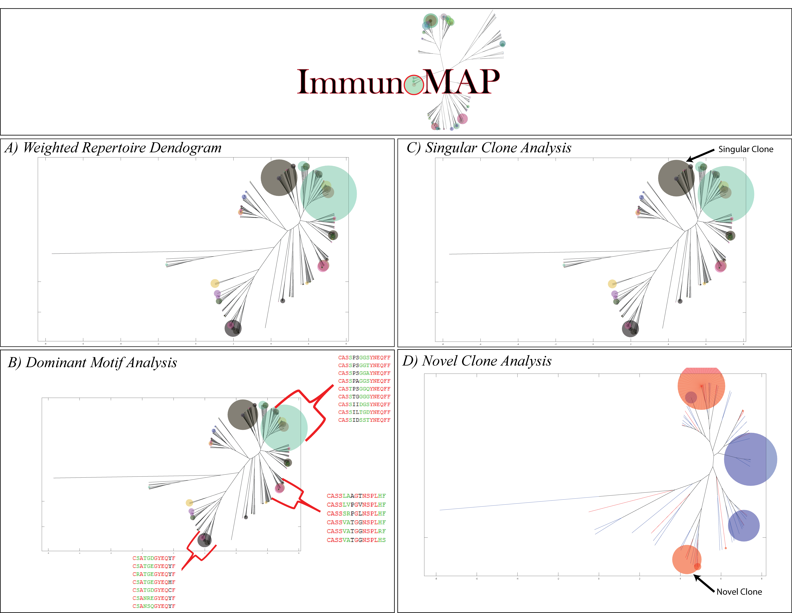
Current Structural Approaches
GLIPH¹
TCR-Dist²
ImmunoMap³
¹Glanville, J., Huang, H., Nau, A., Hatton, O., Wagar, L. E., Rubelt, F., ... & Haas, N. (2017). Identifying specificity groups in the T cell receptor repertoire. Nature, 547(7661), 94.
² Dash, P., Fiore-Gartland, A. J., Hertz, T., Wang, G. C., Sharma, S., Souquette, A., ... & La Gruta, N. L. (2017). Quantifiable predictive features define epitope-specific T cell receptor repertoires. Nature, 547(7661), 89.
³Sidhom, J. W., Bessell, C. A., Havel, J. J., Kosmides, A., Chan, T. A., & Schneck, J. P. (2018). ImmunoMap: A Bioinformatics Tool for T-cell Repertoire Analysis. Cancer immunology research, 6(2), 151-162
Notes:
Describe hamming distance. Figure

Slide 4
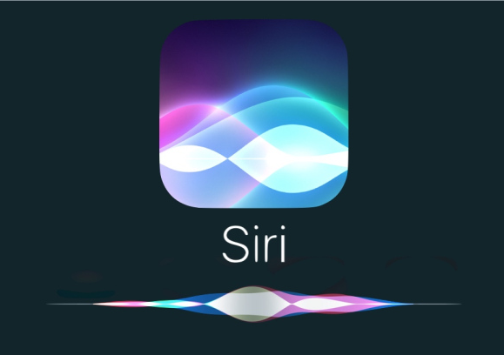
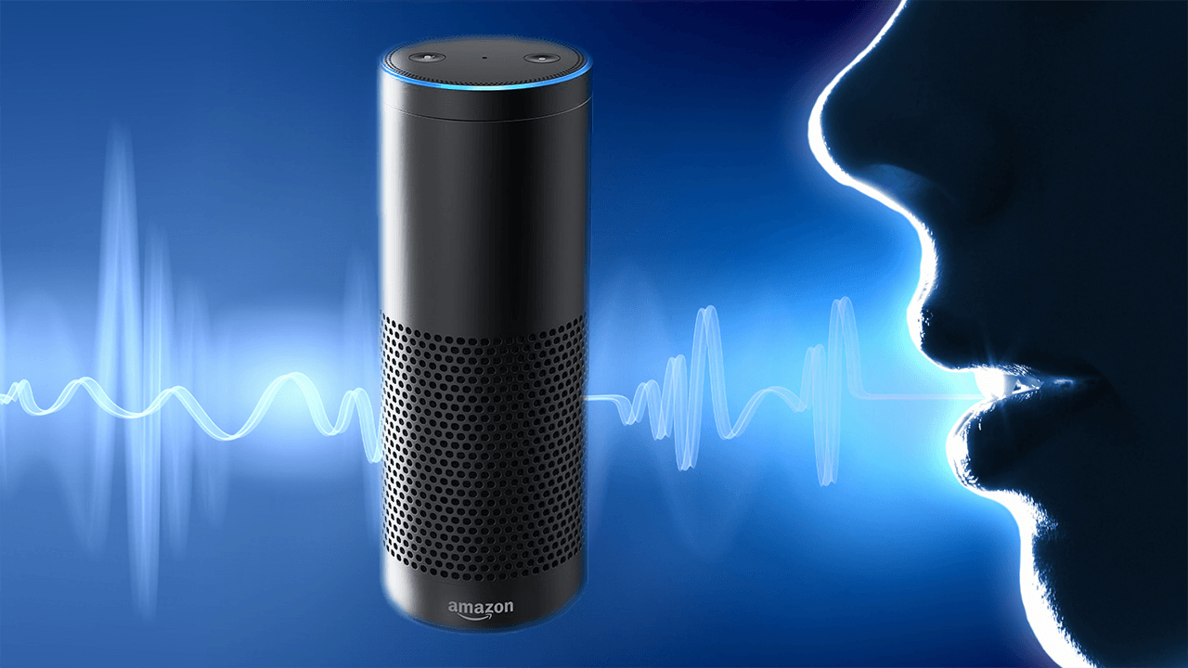
Deep Learning
Deep Learning has shined in areas of pattern recognition, achieving state-of-the-art performance in many fields.
Voice recognition/semantics
Image classification
Universal Function Approximators
Flexibility
High capacity
Domain-specific knowledge not needed (for better or for worse)
Active area of research in ML/AI community
Ideas are spread quickly and adopted easily
Novelty
Open space for innovation

Slide 5
CNN’s for Biological Sequence Analysis
One can convolve across sequences to learn features/motifs that can be used to infer something about the sequence.
DeepBind – learning specificities of DNA/RNA-binding proteins
Alipanahi, B., Delong, A., Weirauch, M. T., & Frey, B. J. (2015). Predicting the sequence specificities of DNA-and RNA-binding proteins by deep learning. Nature biotechnology, 33(8), 831.

Slide 6
Unmet Needs in Cancer Immunology
Determine antigen-specificity of TCR’s
i.e. given a TCR in the tumor, what is it recognizing?
Repertoire-to-Repertoire Comparison
i.e. given TCR-seq from multiple metastatic lesions in a patient, how do these repertoires compare to each other?
Learning structural signatures buried in T-Cell ‘Noise’
i.e. given TCR-seq from patients receiving different immunotherapies or having different responses, is there a predictive structural signature?

Slide 7
DeepTCR
Unsupervised and Supervised Deep Learning Methods to Parse TCRSeq
Unsupervised Approach:
Uncovering structure in data when labels are not provided
Supervised Methods:
Using labeled data to guide training process.
Notes:
Vast majority of repertoire may be irrelevant in cancer. Real limitations to defining repertoires of T-cells against tumor. – shout out to MANAFEST to understand tumor-specific responses.
Take home: this method can swift tumor-specifici signal from the ocean of nosie.
Significance.

Slide 8
Unsupervised Learning

Slide 9
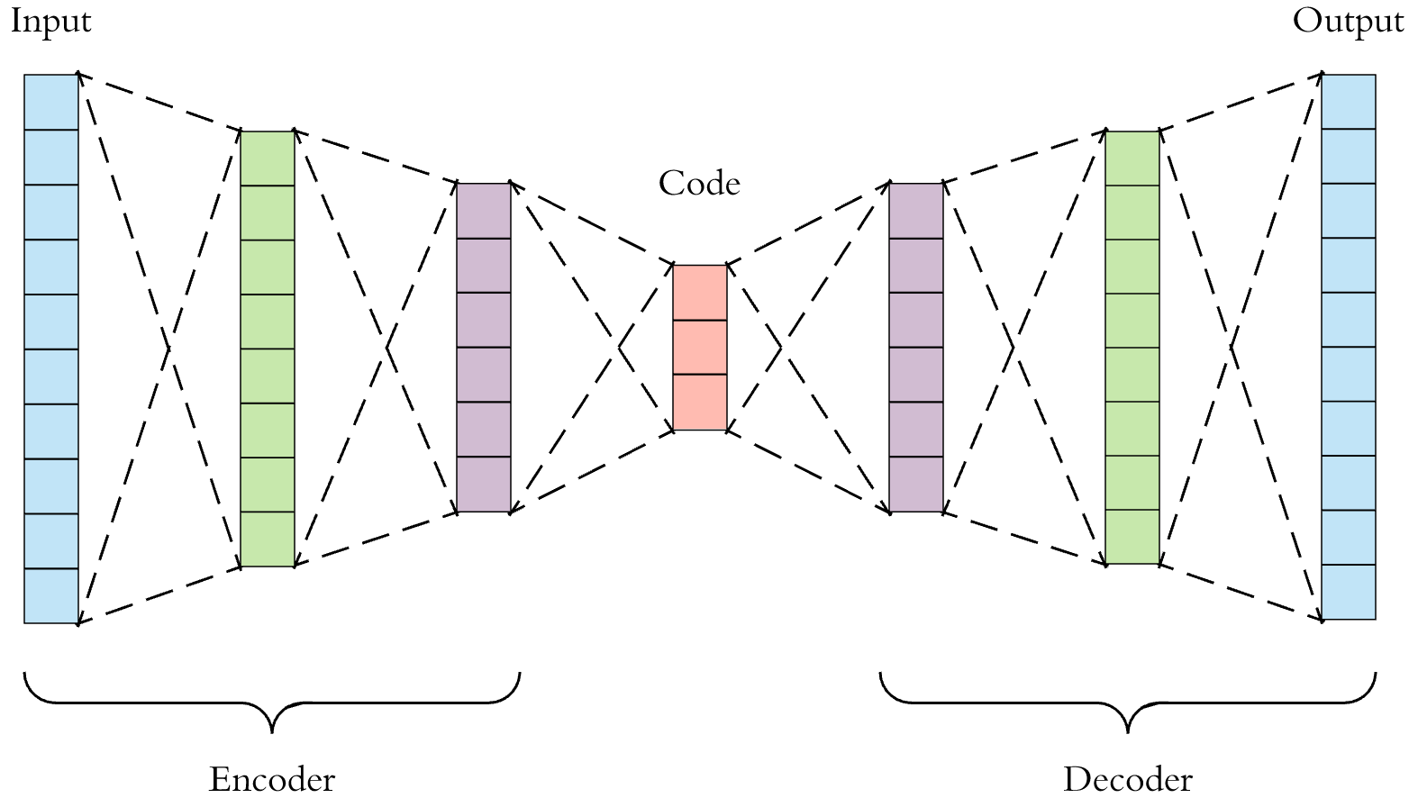
Variational Autoencoder (VAE)
Autoencoder
Dimensionality reduction technique.
Popular choice for learning latent representations of image data.
Objective Function: Reconstruction of the input data
Variational Autoencoder
Secondary Objective Function:
Min(KL(N(μ(X),σ(X)) || N(O,I))

Slide 10
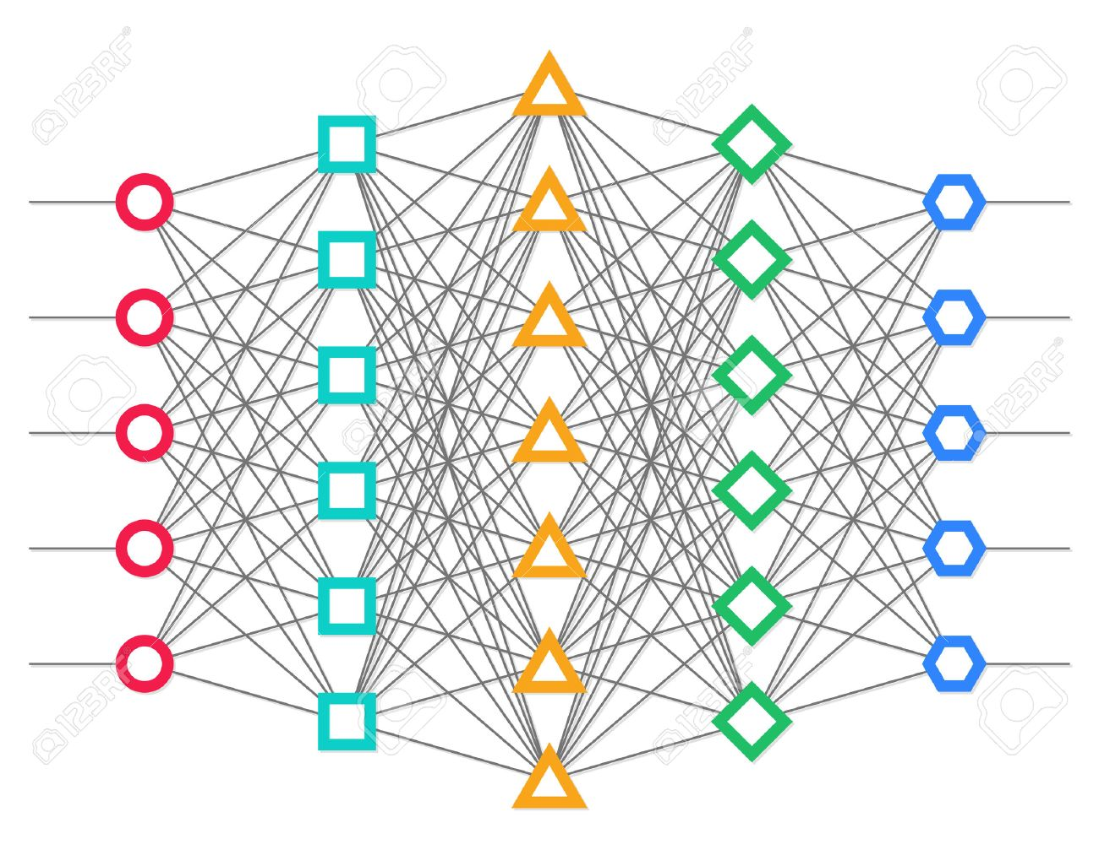
TCR VAE
V/D/J
α/β sequence information
V/D/J
α/β sequence information
Latent Representation

Slide 11
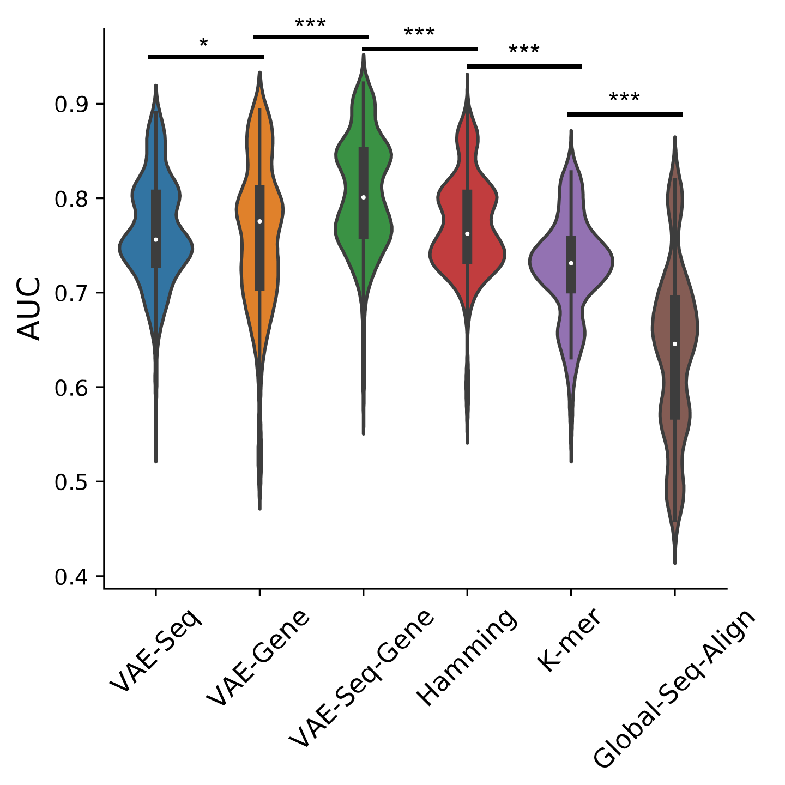
Sequence Clustering
TCR-Seq for 9 Murine Antigens^{1,2}
β-chain
v-gene
j-gene
Methods
VAE-Seq, VAE-Gene, VAE-Seq-Gene
Hamming (GLIPH/TCR-dist)
Global-Seq-Align (ImmunoMap)
K-mer
Instance-based classifier to measure ROC for various methods to classify sequences by their correct antigens
¹ Dash, P., Fiore-Gartland, A. J., Hertz, T., Wang, G. C., Sharma, S., Souquette, A., ... & La Gruta, N. L. (2017). Quantifiable predictive features define epitope-specific T cell receptor repertoires. Nature, 547(7661), 89.
²Sidhom, J. W., Bessell, C. A., Havel, J. J., Kosmides, A., Chan, T. A., & Schneck, J. P. (2018). ImmunoMap: A Bioinformatics Tool for T-cell Repertoire Analysis. Cancer immunology research, 6(2), 151-162

Slide 12
Repertoire Clustering
Cluster TCR Sequences via PhenoGraph¹
Determine proportions of sample in each cluster
Measure distance between repertoires
¹DiGiuseppe, J. A., Cardinali, J. L., Rezuke, W. N., & Pe'er, D. (2018). PhenoGraph and viSNE facilitate the identification of abnormal T‐cell populations in routine clinical flow cytometric data. Cytometry Part B: Clinical Cytometry, 94(5), 744-757

Slide 13
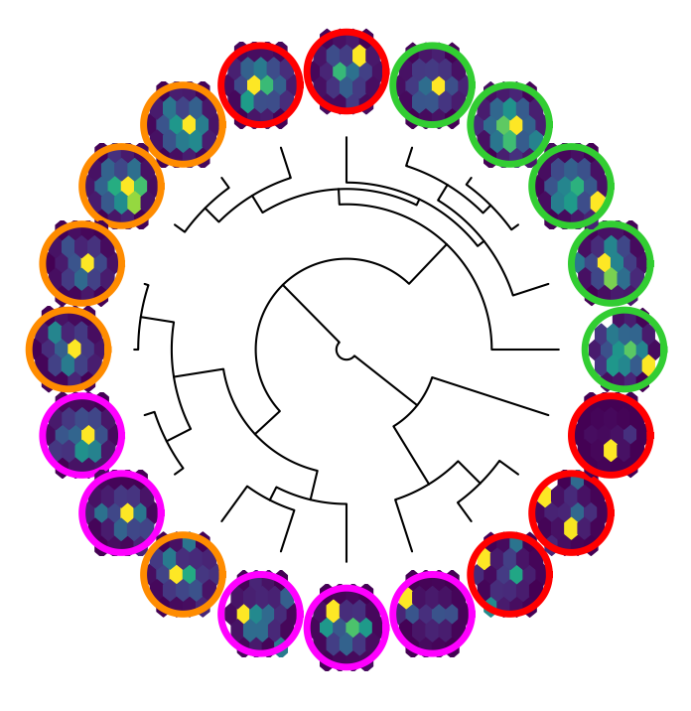
Repertoire Clustering
20 tumor-bearing mice¹
Tx:
Control
9H10 (α-CTLA4)
RT
9H10 + RT
¹Rudqvist, N. P., Pilones, K. A., Lhuillier, C., Wennerberg, E., Sidhom, J. W., Emerson, R. O., ... & Demaria, S. (2018). Radiotherapy and CTLA-4 blockade shape the TCR repertoire of tumor-infiltrating T cells. Cancer Immunol Res, 6, 139-50.

Slide 14
Supervised Learning

Slide 15
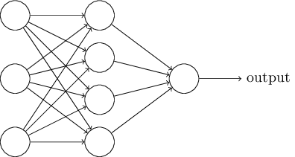
Supervised Sequence Classification
Convolutional Layers
V/D/J
α/β sequence information

Slide 16
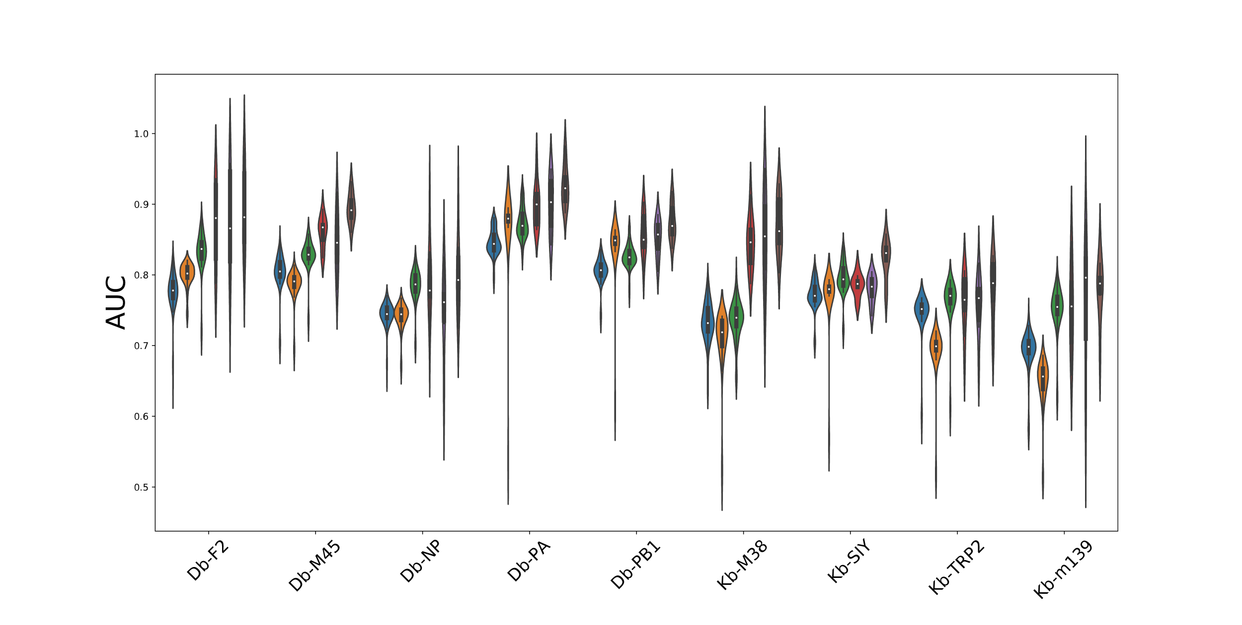
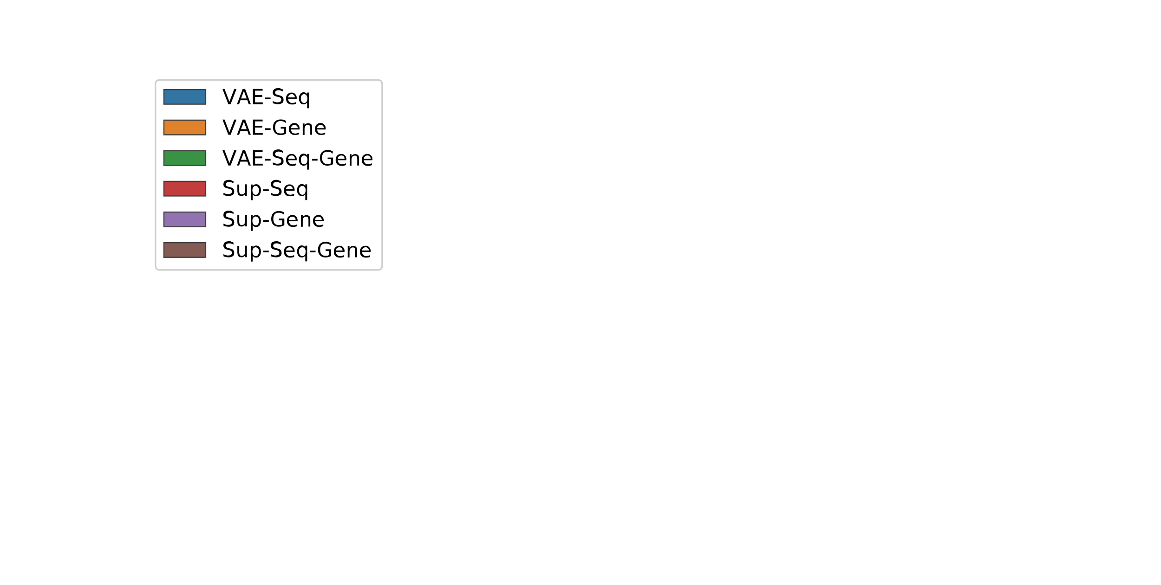
Sequence Classification
Notes:
Alpha/beta – neoantigens

Slide 17
α v β in antigen-specificity
Zhang, S. Q., Ma, K. Y., Schonnesen, A. A., Zhang, M., He, C., Sun, E., ... & Jiang, N. (2018). High-throughput determination of the antigen specificities of T cell receptors in single cells. Nature biotechnology.

Slide 18
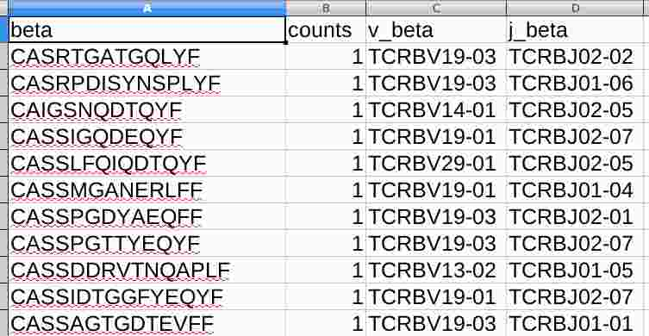
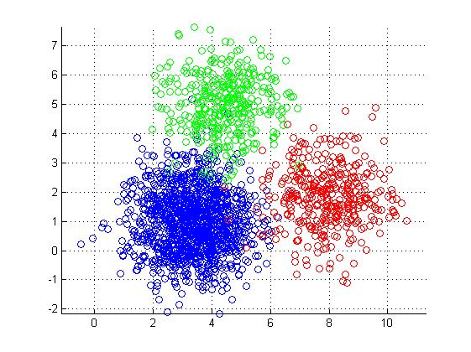
Supervised Repertoire Classification
Convolutional Layers
“on-graph clustering”
Weighted by
Sequence Frequency

Slide 19
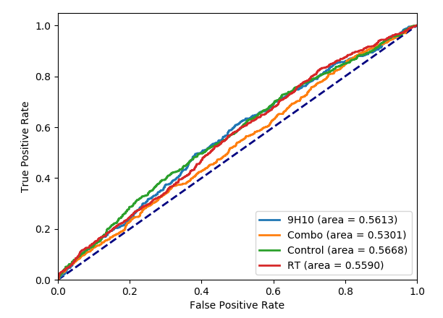
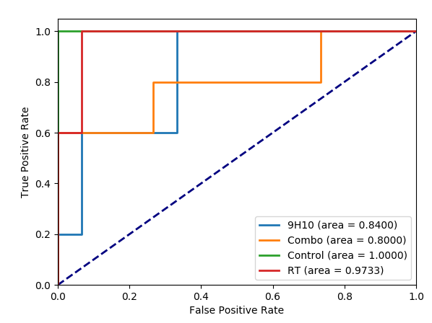
Tx Effects on TIL Repertoire
Sequence Classifier
Repertoire Classifier
Rudqvist, N. P., Pilones, K. A., Lhuillier, C., Wennerberg, E., Sidhom, J. W., Emerson, R. O., ... & Demaria, S. (2018). Radiotherapy and CTLA-4 blockade shape the TCR repertoire of tumor-infiltrating T cells. Cancer Immunol Res, 6, 139-50.
Notes:
Signal ins the noise.

Slide 20
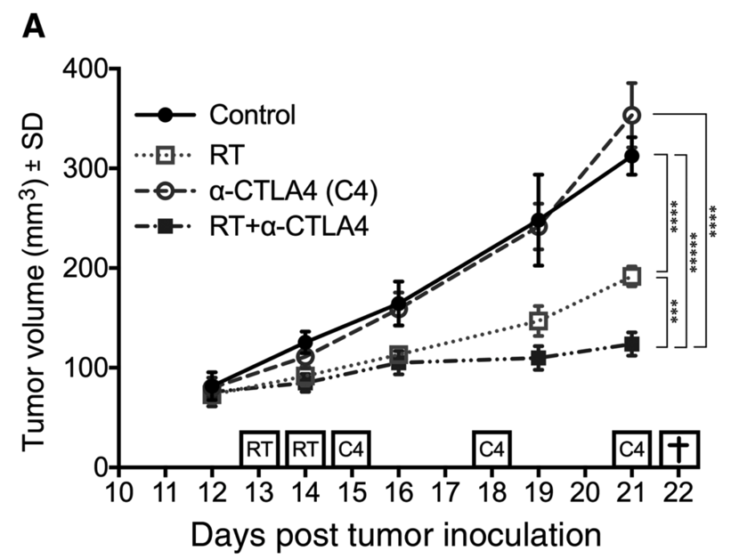
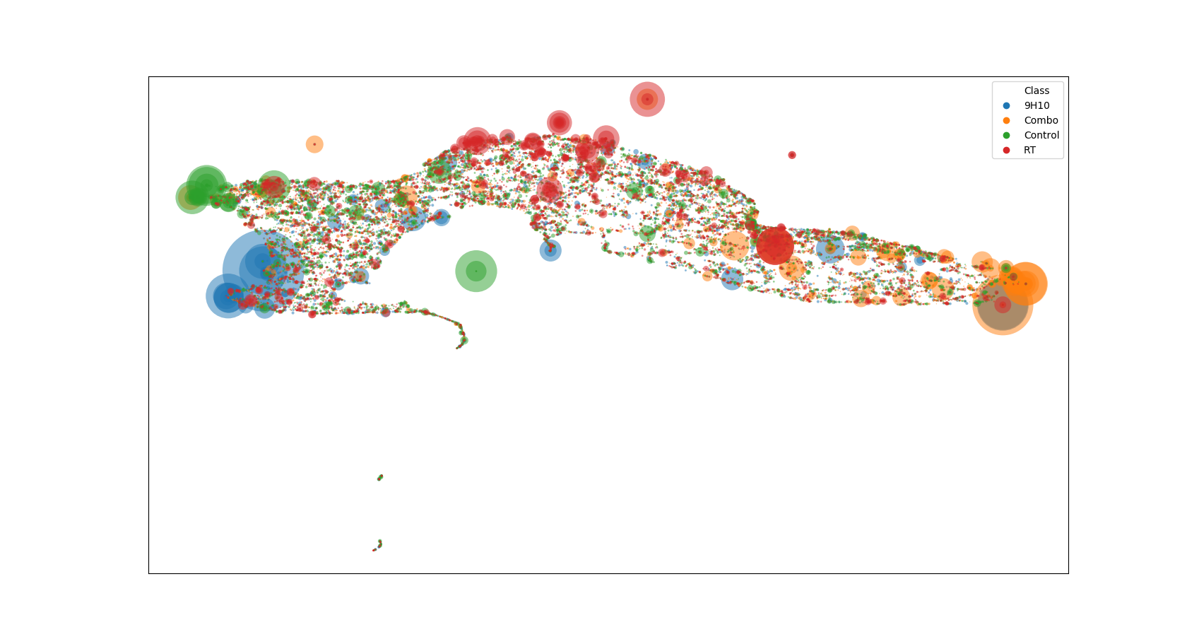
TCR Repertoire Changes Associated with Tumor Progression

Slide 21
DeepTCR…
Improves Sequence Clustering/Classification to antigen-specificity
Performs Structurally-Informed Repertoire Clustering
Detects structural signatures from the ocean of T-Cell “Noise”

Slide 22
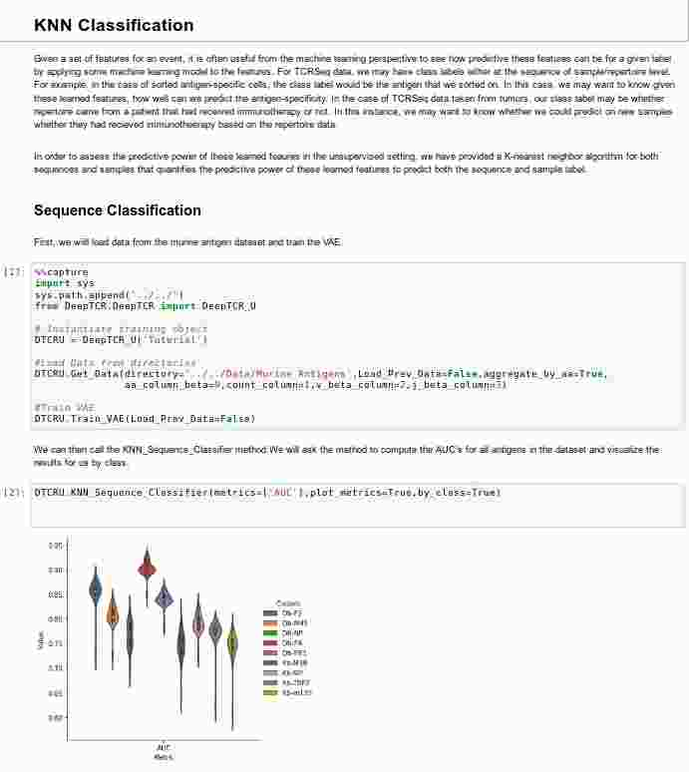
How can you use DeepTCR?
Pre-Print @ Biorxiv
Python Package & Github Repository
https://github.com/sidhomj/DeepTCR
Source Code/Easy Install Instructions
Jupyter Notebook tutorials
Questions?
jsidhom1@jhmi.edu

