Slide 1
Point-of-Service Device for Identification of Dyssynergic Defecation: Final Design Review
April 13, 2011
Student Engineers:
Powell Perng
Liting Chen
Chris Jaeger
Julie Foucher
John Sidhom

Slide 2
Chronic Constipation
Motivation
Laxative/Dietary Treatment Effective
Laxative/Dietary Treatment Ineffective
U.S. Constipation Treatment Population (30 Million)
U.S. Constipation Population (63 Million)

Slide 3
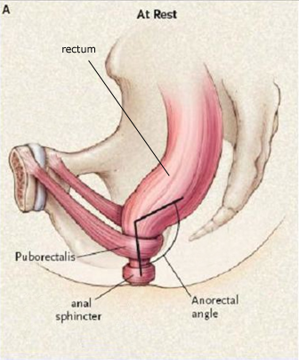
Dyssynergic Defecation (DD)
Problem
Proper treatment: biofeedback therapy
Physical training regimen
80% positive response rate
Key Events:
Anal Sphincter Relaxation
Intrarectal Pressure/Abdominal Contraction
Puborectalis Relaxation
Lembo, A. 2003
Notes:
Dysynergic Defecation or DD occurs when one or more of these key events during defection is compromised. Thes

Slide 4
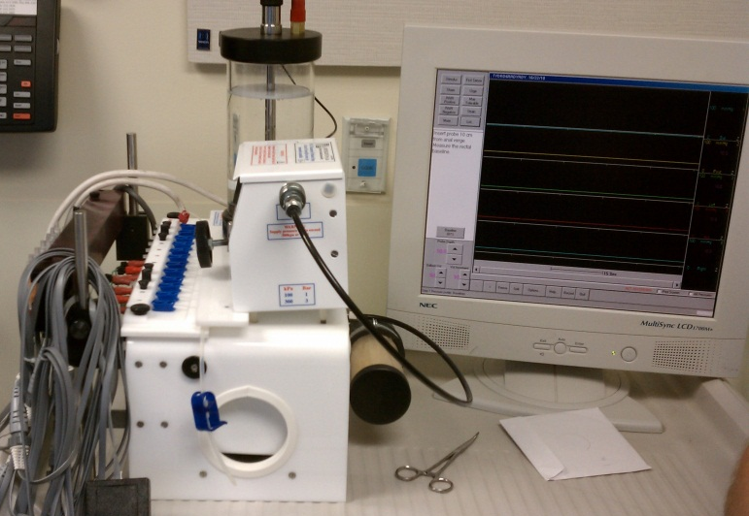
Current Situation: Anorectal Manometry (ARM)
Problem
Catheter-based system
Anal sphincter pressure
Drawbacks
Prohibitive costs
Complicated data analysis
Limited measurements
University of Michigan Gastrointestinal Laboratory
Notes:
This allows the physican to monitor asynchrnous contractions—meaning that the sphincter does to relax in time with the volunteer abdominal muscle contraction—as well as paradoxical contractions, meaning that the sphincter contracts when it should in fact relax.
The current gold standard diagnostic tool for dyssyergic defecation is a machine called Anorectal Manometry. It is a catheter-based system which is inserted within the patients rectum, and measures anal sphincter squeeze pressures of the patient to assess asynchronous or paradoxical contractions of the sphincter during the act of defecation.
Despite being the gold standard, however, ARM is cost-prohibitive for both health care providers as well as for patients. With a base unit price of $75,000 and over $300,000 dollars in yearly maintenance fees for the machine, ARM is available in fewer than 200 clinics across the United States. All of these factors combined makes the entire diagnosis procedure quite expensive, such that by the time the patient is actually diagnosed with dyssynergia, the total cost of the medical procedure is right around $2800 (and this doesn’t account for the ineffective laxative treatments/fruitless physician visits).

Slide 5
Current Treatment Pathway
Problem
Days
Weeks
Months
$1300/patient
Patient
Primary Physician
Dietary/Laxative Treatment
GI Specialist ARM Clinic
Biofeedback Therapy
Recovery
Notes:
Benefits of GastroAnalytics Solution
Low cost
Automated software data analysis
More comprehensive assessment
Sooner treatment

Slide 6
Goal: GastroAnalytics Solution
Problem
Point-of-service identification
Improved measurements
Automated data interpretation
Notes:
The gastro analytics solution is to empower primary care physicians with a point of service diagnostic tool that will enable them to identify patients suffering from DD at the first physician visit. In this manner, our solution will eliminate unncessary time and costs associated with ineffective laxative treatments and ARM tests, and the patient can be referred to proper therapy sooner and begin recovery sooner as well. Our device will also improve on ARM measurements by taking into account puborectalis activity and intrarectal pressure as well as anal sphincter squeeze pressures. Our device will also feature automated data analysis so the user won’t have to

Slide 7
Critical Design Requirements
Requirements
Requirement | Specification
Measure Pressure | -30 – 300 mmHg 5 mmHg resolution
Measure Electromyography (EMG) | 0-250 μV
Finger-based | ≤ 3 mm thickness
Maintain finger function | ≥90° flexion
Maximize patient comfort | Optimize through testing
Calibration of device | Yes
Interface with personal computer | Windows XP, Vista, or 7®
Relay data | ≤ 200 ms delay
Low production cost | ≤ $75 per disposable device
Electrical safety | Meet IEC 60601-1 standards
Temperature performance | 15 °C to 45 °C
Biocompatibility | Meet AAMI/ANSI/ISO 10933 standards
Notes:
Critical Design Requirements will be distributed on a handout along with specs, budget and timeline information

Slide 8
Critical Design Requirements
Requirements
Requirement | Specification
Measure Pressure | -30 – 300 mmHg 5 mmHg resolution
Measure Electromyography (EMG) | 0-250 μV
Calibration of device | Yes
Interface with personal computer | Windows XP, Vista, or 7®
Relay data | ≤ 200 ms delay
Temperature performance | 15 °C to 45 °C
Finger-based | ≤ 3 mm thickness
Maintain finger function | ≥90° flexion
Maximize patient comfort | Optimize through testing
Low production cost | ≤ $75 per disposable device
Electrical safety | Meet IEC 60601-1 standards
Biocompatibility | Meet AAMI/ANSI/ISO 10933 standards
Notes:
Critical Design Requirements will be distributed on a handout along with specs, budget and timeline information

Slide 9
Critical Design Requirements
Requirements
Requirement | Specification
Measure Pressure | -30 – 300 mmHg 5 mmHg resolution
Measure Electromyography (EMG) | 0-250 μV
Calibration of device | Yes
Interface with personal computer | Windows XP, Vista, or 7®
Relay data | ≤ 200 ms delay
Temperature performance | 15 °C to 45 °C
Finger-based | ≤ 3 mm thickness
Maintain finger function | ≥90° flexion
Maximize patient comfort | Optimize through testing
Low production cost | ≤ $75 per disposable device
Electrical safety | Meet IEC 60601-1 standards
Biocompatibility | Meet AAMI/ANSI/ISO 10933 standards
Notes:
Critical Design Requirements will be distributed on a handout along with specs, budget and timeline information

Slide 10
Critical Design Requirements
Requirements
Requirement | Specification
Measure Pressure | -30 – 300 mmHg 5 mmHg resolution
Measure Electromyography (EMG) | 0-250 μV
Calibration of device | Yes
Interface with personal computer | Windows XP, Vista, or 7®
Relay data | ≤ 200 ms delay
Temperature performance | 15 °C to 45 °C
Finger-based | ≤ 3 mm thickness
Maintain finger function | ≥90° flexion
Maximize patient comfort | Optimize through testing
Low production cost | ≤ $75 per disposable device
Electrical safety | Meet IEC 60601-1 standards
Biocompatibility | Meet AAMI/ANSI/ISO 10933 standards
Notes:
Critical Design Requirements will be distributed on a handout along with specs, budget and timeline information

Slide 11
System Block Diagram
System Overview
NO
PC Laptop
Finger Device
Sensors
Wrist Box
Circuitry
DYSSYNERGIC DEFECATION?
Algorithms
FURTHER TESTING
Notes:
So here is a system block diagram for our solution showing the flow of information. Our finger device will capture data from the patient. Data will be passed through our conditioning circuitry into a PC laptop where diagnostic algorithms will interpret the signals and output a diagnostic recommendation to the user. Rationale is very obvious, “and as such…” and finger device carries w/ it a lot of the design requirements

Slide 12
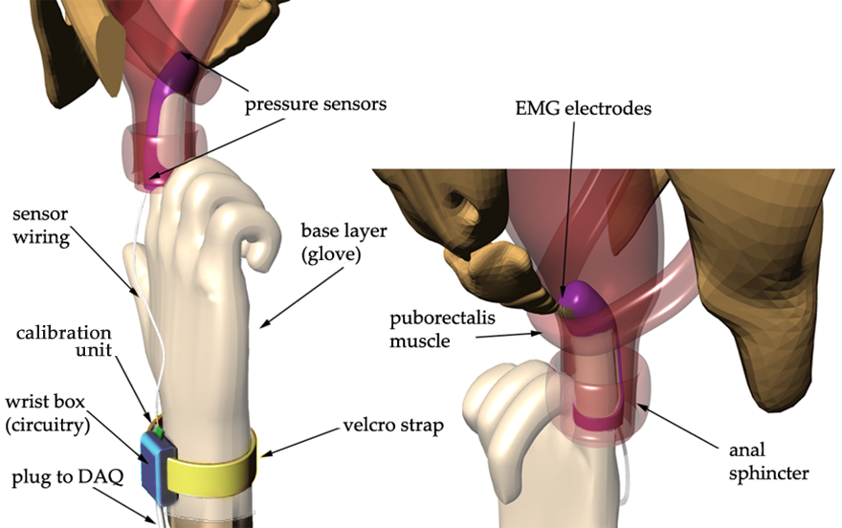
System Overview
Notes:
5 minutes and 20 seconds to get here

Slide 13
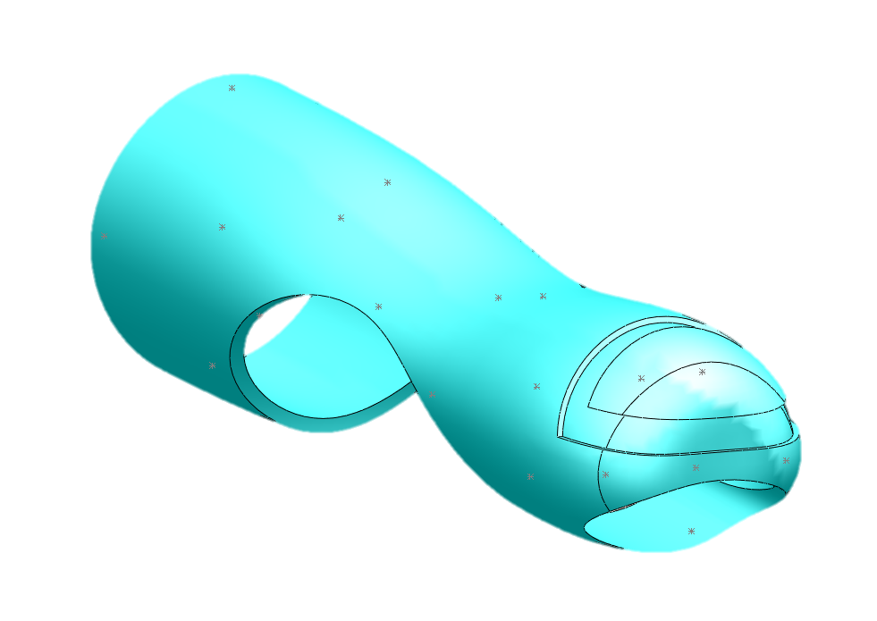
Inner Layer
Device Housing
Groove for Hard Support
Hole to Maintain Sense of Touch
Lead Material Choice: Silicone
Option: Polyurethane
Notes:
Text box to left or up top: bullet the primary requirements of the inner layer, “lead candidate material… silicone, option: polyurethane” (duplicate the text box on multiple slides)

Slide 14
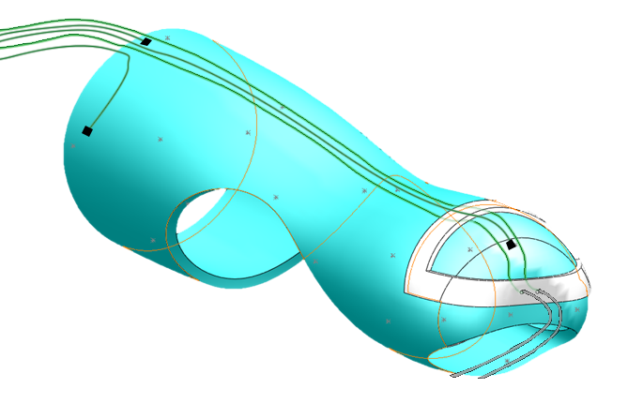
Middle Layer
Device Housing
Hard plastic support
Wiring to
wrist box
Holes to stabilize EMG electrodes
Anal sphincter pressure
sensors
Intrarectal pressure sensor
EMG electrodes
Lead Material Choice: HDPE
Option: PP
Notes:
http://www.zeusinc.com/UserFiles/zeusinc/Documents/Zeus_Biocompatibility.pdf

Slide 15
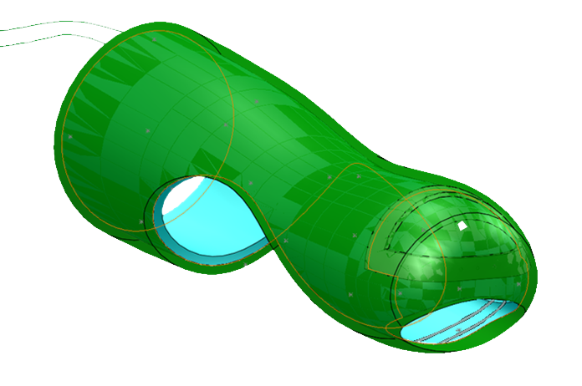
Outer Layer
Device Housing
Smooth overlay
Silicone adhesive
Lead Material Choice: silicone
Lead Adhesive Choice: Nusil MED3-4013
Notes:
As adhesives for bonding and
sealing silicones to each other and
other substrates such as metals and
plastics
• For rapid production or prototyping
due to a rapid cure
They shall not be
considered for use in human
implantation for a period of greater
than 29 days.

Slide 16
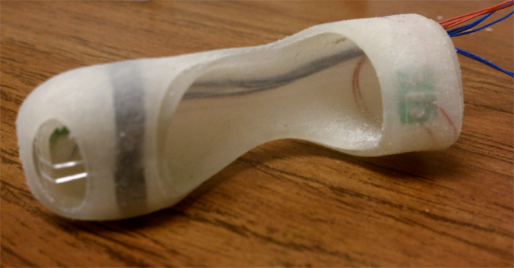
EMG: System Overview
EMG
Silver wire electrodes
Signal validation from previous study
Puborectalis EMG (Cescon, et. al. 2006)
Surface electrode testing
Differential
configuration

Slide 17
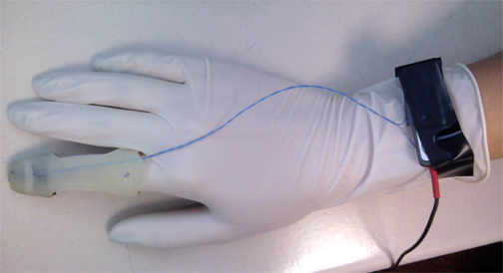
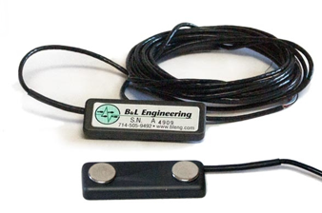
System Overview
EMG
B&L Engineering Electrode and Signal Conditioning Specifications
Specification | Value
Preamplifier Gain | 330
Bandpass Filter | 10-500 Hz
Amplifier Gain | Variable
Signal Output | Raw/RMS
This table summarizes the specifications for the B&L EMG electrode and signal conditioning unit.

Slide 18
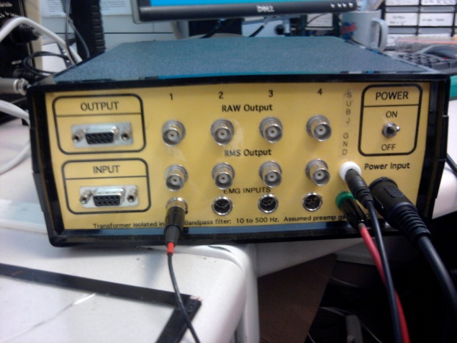
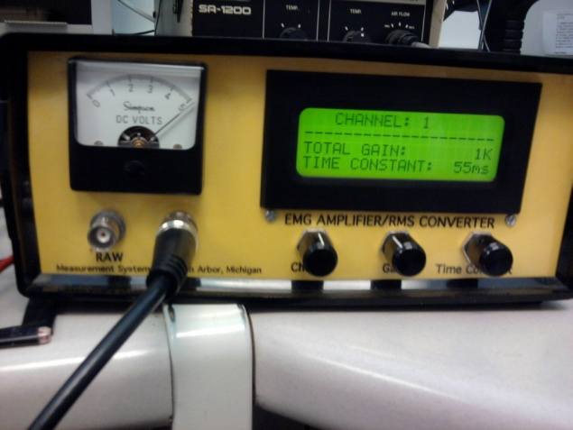
System Overview
EMG
B&L Engineering Electrode and Signal Conditioning Specifications
Specification | Value
Preamplifier Gain | 330
Bandpass Filter | 10-500 Hz
Amplifier Gain | Variable
Signal Output | Raw/RMS
This table summarizes the specifications for the B&L EMG electrode and signal conditioning unit.
adjust gain
pre-amp plug
cable to DAQ

Slide 19
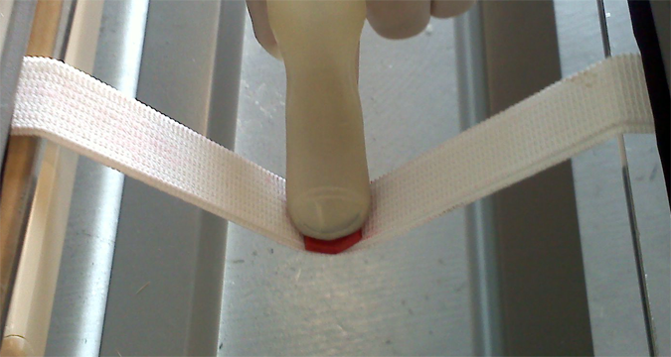
Contact Area Testing
EMG
Validation of adequate contact area
Determined initial electrode configuration
28 gauge wire electrodes
4 mm spacing
Notes:
“We’ll do a pilot test to see what the standard deviation and adjust the trial size accordingly”

Slide 20
Human Testing
EMG
Recording of EMG biopotential (voltage)
Under IRB review on 4-13-11
Model system: lip muscles
Thin layer of fascia
Striated muscle underneath
One-tailed t-test
Ten trials per test case
H₀: V_{contract} = V_{resting}
H₁: V_{contract} > V_{resting}
Notes:
“We’ll do a pilot test to see what the standard deviation and adjust the trial size accordingly”

Slide 21
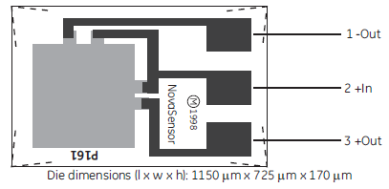
Pressure: System Overview
Pressure
P161 Pressure Sensor Die Schematic by GE

Slide 22
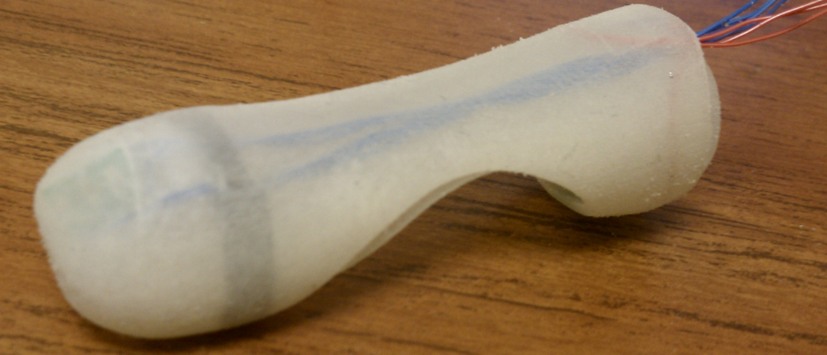
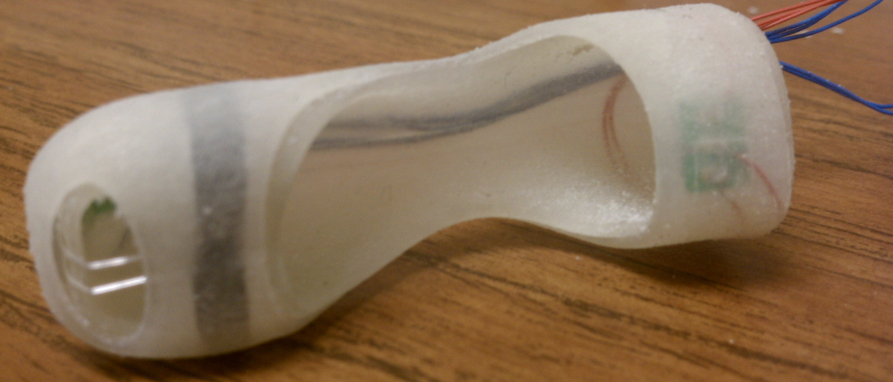
Setup: Prototype
Pressure
Intrarectal pressure sensor
Wire bond
Anal sphincter pressure sensor

Slide 23
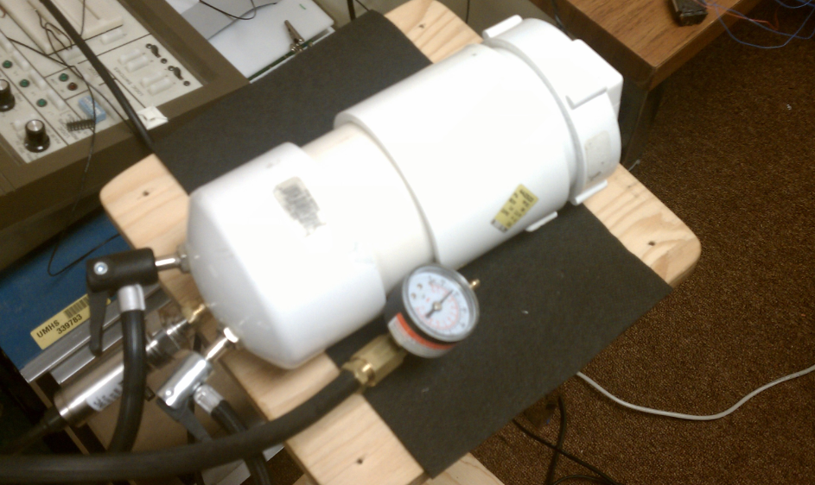
Setup: Chamber
Pressure
Chamber Cap
Compressor Valve
Pressure
Chamber
Pressure
Transducer
Pressure Release Valve
Notes:
In order to simulate the types of pressures our device would need to measure, we created a pressure chamber utilizing PVC piping. As we can see in this photograph, we mounted our sensor in the cap of the chamber and had wires coming out of the chamber. We then attached two vent valves in order to control the pressure within the chamber and measure the pressure at any given moment.

Slide 24
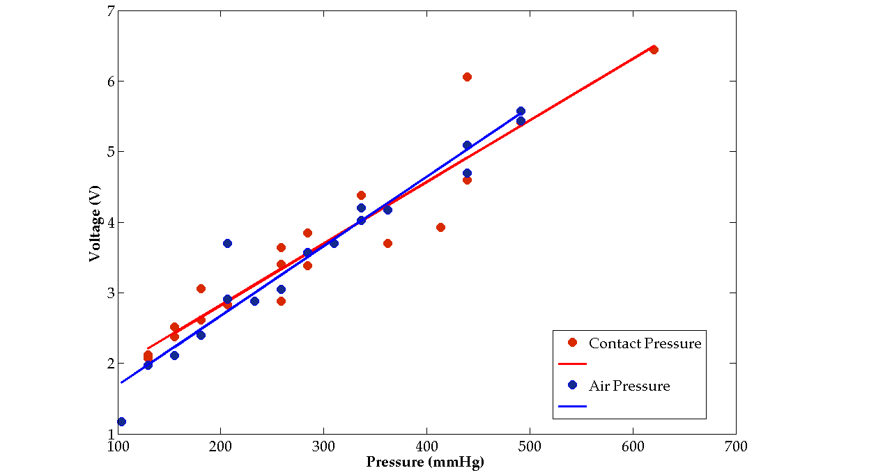
Preliminary Testing Contact Pressure vs. Air Pressure
Pressure
R² = 0.895
R² = 0.940
*Pressure values converted from PSI to mmHg
**Voltage signal amplified 20x

Slide 25
Sensor Calibration: Zero Offset
Pressure
Goal: Offset = 0 V
Calibrating to atmospheric pressure
Complete bridge with 1k-Ohm potentiometers (Rz1 & Rz2)
Adjust Rz1 & Rz2
V(Out+)-V(Out-) = 0V
Notes:
Use as reference

Slide 26
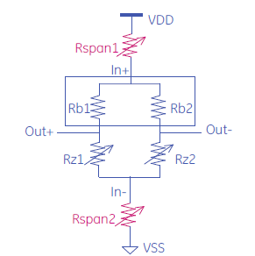
Sensor Calibration: Sensitivity
Pressure
Goal: Sensitivity → 5µV/V/mmHg
Add 1kΩ POT’s (Rspan1 & Rspan2) to tune sensitivity
Adjust Rspan1 & Rspan2
Rspan1 = Rspan2
@300mmHg and 5V
V(Out+)-V(Out-) = 7.5mV

Slide 27
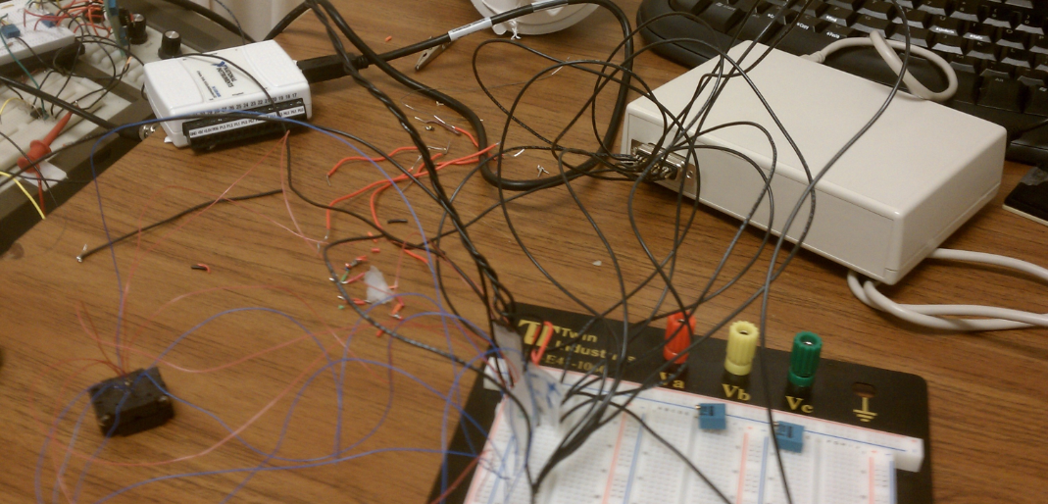
Microbridge
Pressure
USB DAQ
Disposable chip solution to calibration steps
Designed for p161
Zero offset
Sensitivity
Package also includes trimming kit and socket
Socket
Trimming kit

Slide 28
Intrarectal Sensor Calibration
Pressure

Slide 29
Anal Sphincter Sensor Calibration
Pressure

Slide 30
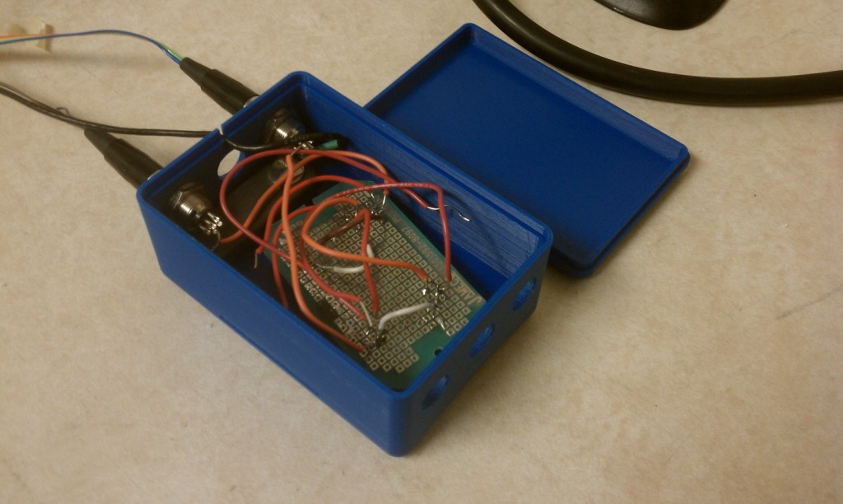
Wrist Box
Signal Processing
Calibration Unit
EMG Preamplifier
Switchcraft TA5
5 pin Plugs
Velcro Wrist Strap
Pressure Amplifiers
Notes:
Circuit diagram?

Slide 31
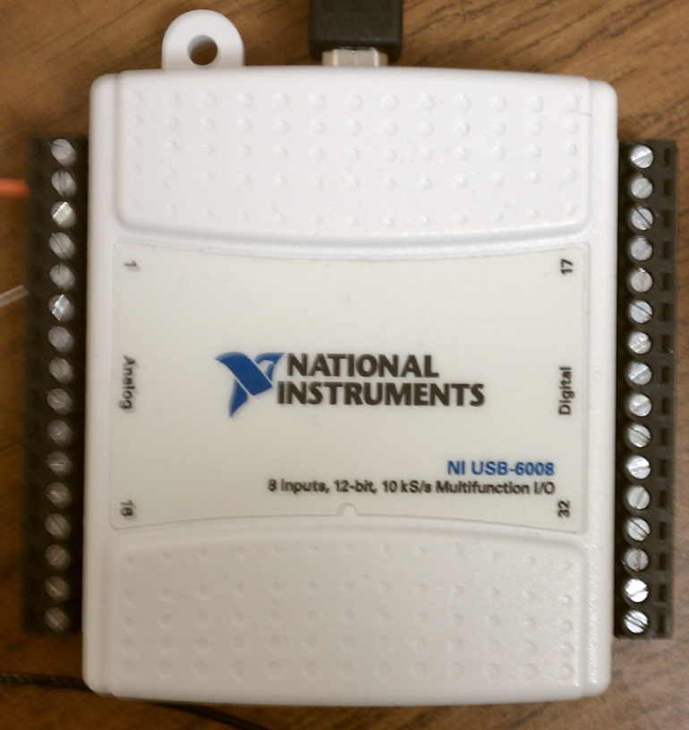
NI USB-6008 DAQ Device
Signal Processing
Interface with PC: Windows XP, Vista, 7®
USB compatible
LabVIEW compatible
Relay data: ≤ 200 ms delay
10 kS/s sample rate
2000 samples/ 200 ms

Slide 32
Software Overview
Software
NI LabVIEW- based
Intended for preliminary clinical testing
Allows for signal viewing and control of diagnostic criteria
Easily modified for point-of-service use
Data collected in MS Excel for post-test viewing

Slide 33
Software Overview
Software
Input
Algorithm
Output
Signals
Coord:
Yes
No
Normal / Abnormal
Thresholds
IR:
IR ↑
IR ↓
IR ↔
↑/ ↓ ∆ in Signals
PR:
PR ↓
PR ↑
PR ↔
Real-time Waveforms
AS:
AS ↓
AS ↑
AS ↔
Recorded Data
Oscilloscope
All True =
Normal
Any True=
Abnormal
AS = Anal Sphincter Pressure
PR = Puborectalis EMG
IR = Intrarectal Pressure
Coord = Coordinated
Notes:
The basic algorithm we have developed is shown on this slide. Up and down arrows indicate changes in magnitude of the signal from baseline to defecation. The double headed arrow indicates a magnitude change of less than 20%, which we will consider constant. Synchrony will be defined as the three signals occurring within a given time period relative to each other. Since synchrony of these signals is not currently tested, we will only be able to define this time period after testing with our clinical prototype. If the algorithm follows the path outlined in green, it indicates a normal patient and returns a result of “no” for dyssynergic defecation. Deviations from this pathway indicate the patient is abnormal and requires further testing to confirm dyssynergic defecation.

Slide 34
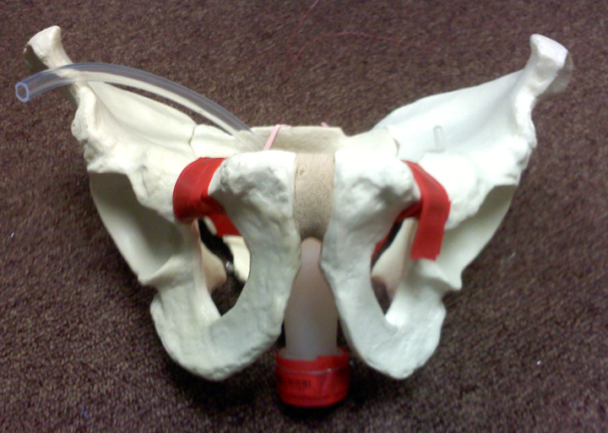
Anatomical Model
Demonstration
Pressure Tube to Bike Pump
Puborectalis
Rectum
Anal Sphincter

Slide 35
Conclusions
Defined clinical problem and engineering design requirements
Refined consensus design concept
Validated device subsystems
Calibrated pressure sensors
Developed software interface and algorithms
Awaiting IRB approval for EMG
Notes:
adjust this??

Slide 36
Future Steps
Assemble functional prototype
EMG validation: IRB approval
Incorporate calibration unit
Manufacture clinical prototypes
Raise capital for production and testing
Determine manufacturing process
Submit invention disclosure

Slide 37
Acknowledgements
Dr. William D. Chey
Director of the Gastrointestinal Physiology Laboratory, University of Michigan
Dr. James Ashton-Miller
Director of the Biomechanics Laboratory, University of Michigan

Slide 38
QUESTIONS?

Slide 39
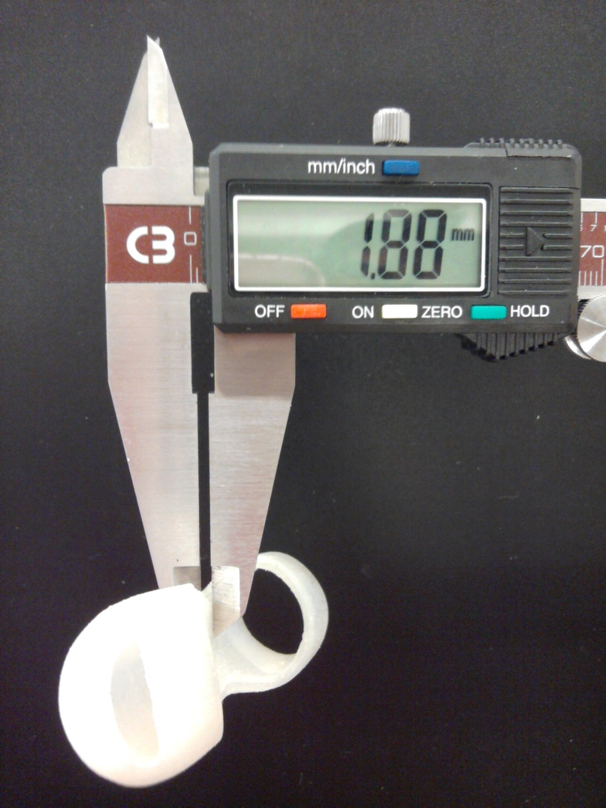
Finger Based: ≤ 3mm Thickness
Demonstration
CAD: ≤ 2mm total thickness
5 measured thicknesses
1.75-1.98 mm range
Housing | 1.98 mm
Glove | 0.125 mm
Sensors | 0.17 mm
Wiring + | 0.3 mm
Max. Thickness = | 2.575 mm
Digital calipers
Device housing

Slide 40
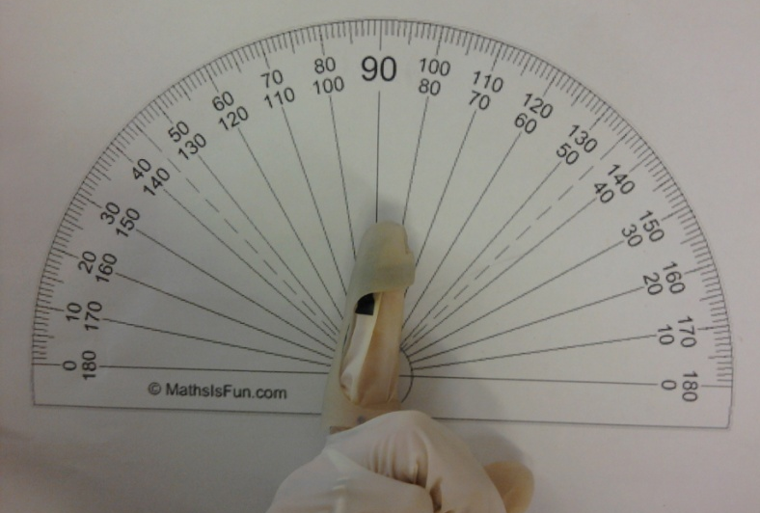
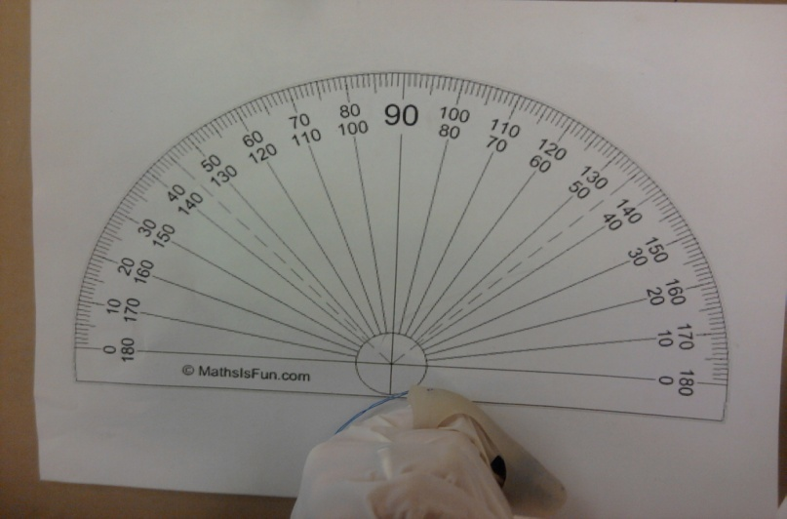
Finger Function: ≥ 90° flexion
Demonstration
Usability questionnaire flexion/extension rating
Average rating: 4.6/5
Client rating: 5/5
Measured degree of flexion: 140 °
140 °

Slide 41
Maximize Patient Comfort
Demonstration
Usability questionnaire
Client + 5 other participants
Rate features of device from patient perspective
1-5 scale
5 = best rating
Notes:
Who are these other participants? Behaving as doctors/users? Clarify what perspective is being tested
-not ‘random’ participants

Slide 42
Maximize Patient Comfort
Demonstration

Slide 43
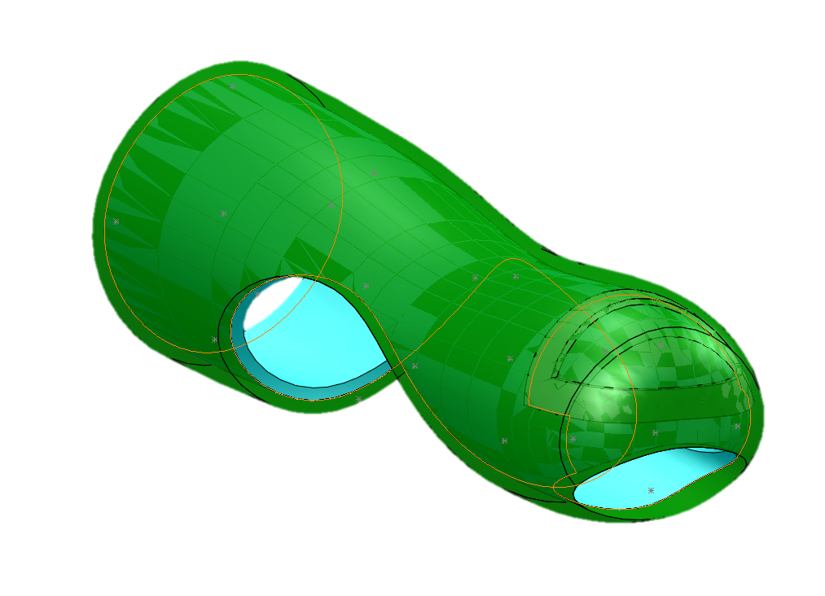
Patient Comfort: Next Steps
Demonstration
Material/Smoothness – Material selection
Current prototype: Resin from MIC
Clinical prototype: Silicone with desirable material properties
Size/Shape – Revised device design
Graded edges
3 mm
2 mm

Slide 44
Low Production Cost ≤ $75 per disposable device
Validation
Known Costs:
Latex glove
Pressure sensors
EMG electrodes
Thin insulated wire
Plug
Total cost = $38.89
Additional Costs :
Polyurethane, silicone, plastic support manufacturing
Device assembly
Packaging
Future Steps:
Secure means of manufacturing + assembly < $75 – $38.89 = $36.11
Injection molding for device housing
Wire bonding and packaging pressure sensors

Slide 45
Safety Standards
Validation
Electrical Safety Standard: AAMI 60601-1
Medical grade isolation transformer (EMG)
Low-power instrumentation amplifiers
Battery-powered pressure sensors
IRB approval before clinical testing
Biocompatibility Standard: AAMI 10933
Biomedical grade device housing materials
Medical grade pressure sensors
Biocompatible silver EMG electrode

Slide 47
Low Production Cost: ≤ $75 per disposable device
Component | Quantity | Source | Cost per device, $
Latex Glove | 1 | GO Gloves | 0.08
Pressure Sensor | 5 | GE Sensing | 37.95
EMG Wires | 3, 1 cm each | Bead Gallery | 0.10
Thin Insulated Wire | 7 ft | Radio Shack | 0.56
Plug | 1 | Belkin Components | 0.20
 |  | TOTAL | 38.89

Slide 48
Electrical Safety Standard: AAMI 60601-1
Perform risk management process
Identify essential performance
State expected service life
Meet requirements for parts contacting body
Single fault safe risk mitigation
Use components within specified ratings
< 250 V power supply for handheld equipment

Slide 49
Electrode Contact Length (mm)
 |  | Electrode Diameter (mm)
 |  | 0.3 | 0.55 | 0.8 | 1.04 | 1.44 | 1.85
Electrode Spacing (mm) | 2 | 5.163 | 5.573 | 7.262 | 6.258 | 8.053 | 7.207
 | 4 | 7.220 | 6.972 | 7.825 | 7.072 | 8.702 | 7.125
 | 6 | 6.275 | 6.973 | 6.915 | 6.702 | 7.635 | 7.837
 | 8 | 7.585 | 5.458 | 6.865 | 6.087 | 8.013 | 6.687
 | Average | 6.561 | 6.244 | 7.217 | 6.530 | 8.101 | 7.214

Slide 50
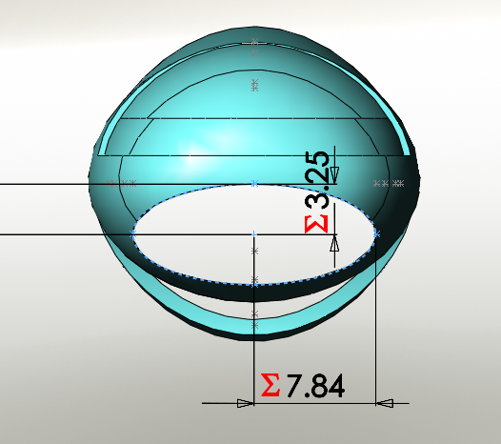
EMG Exposure Dimensions
Dimensions are in mm

Slide 51
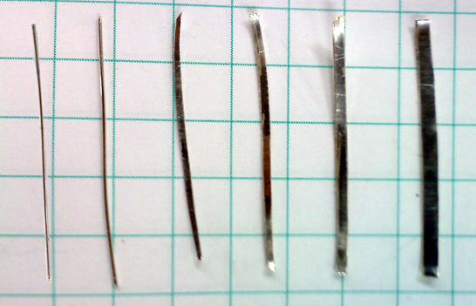
0.925 Sterling Silver Electrodes
Validation: EMG
diameter (mm)
0.30
0.55
0.88
1.04
1.41
1.85
width (mm)
round wires
0.23 mm thick strips

Slide 52
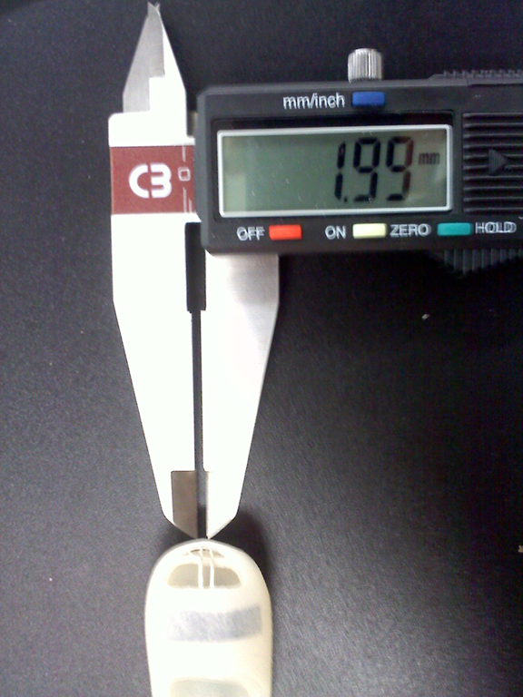
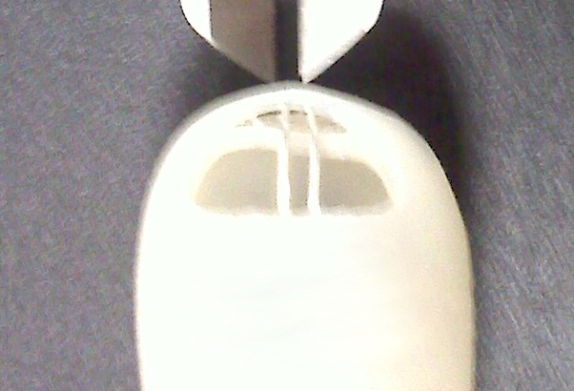
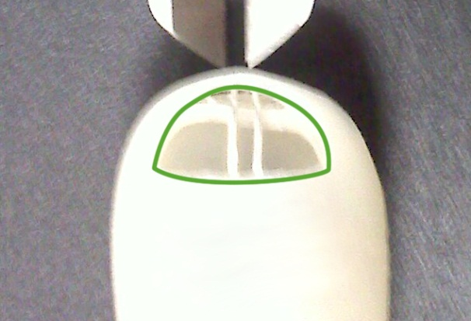
Contact Area: Test Cases
Validation: EMG
2 – 8 mm spacing
3 trials/configuration

Slide 53
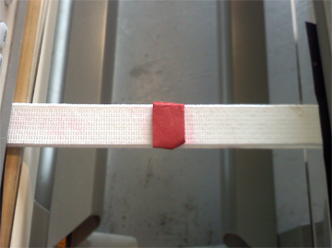
Contact Area: Model
Validation: EMG
Puborectalis contact model
Contractile tissue (elastic)
Clay blocks to visualize imprint
12 cm
7 cm

Slide 54
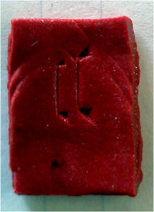
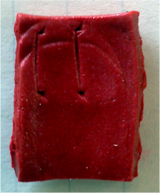
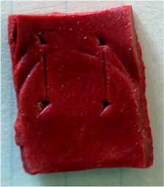
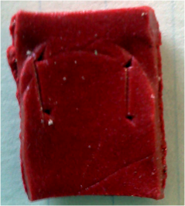
Contact Area: Measurement
Validation: EMG
Length determined with digital calipers
Assume full contact width (qualitative)
2 mm
4 mm
6 mm
8 mm

Slide 55
Electrode Contact Area
Validation: EMG
Notes:
What’s the minimum acceptable?

Slide 56
Area Gained/mm of Width
Validation: EMG
Notes:
What’s the requirement for contact area? Are all of these acceptable? (what’s the minimum requirement) leave the error bars in for style points (we have limited statistical power because of our n)
skin effect at higher frequency

Slide 57
Timeline
Milestones achieved:
Consensus concept: 11/22/10
Pressure subsystem validated: 2/13/11-4/12-11
Wrist box constructed: 3/25/11
Software validated: 3/28/11
Anatomical model for testing constructed: 4/8/11
Remaining milestones:
First functional prototype
First clinical prototype
Remaining critical issues:
IRB approval for EMG lip testing (4/14/11)
Material availability (P161 sensors and Microbridge chips)

Slide 58
Budget
Initial budget: $2000
Total spent to date: $1653.41
Amount under budget: $346.59
Pending expenses: Lurie Nanofabrication Laboratory ~ $500.00
Pending budget increases
Dare to Dream Assessment Grant: $1500
CTSA Grant: $5000
CFE Prototyping Grant: $1000

Slide 59
References
Martin, B., Barghout, V., & Cerulli, A. (2006). Direct medical costs of constipation in the united states. Managed Care Interface, 19(12), 43-49.
Johanson, J. F., & Kralstein, J. (2007). Chronic constipation: A survey of the patient perspective. Alimentary Pharmacology Therapeutics, 25(5), 599-608.
Schiller LR, Dennis E, Toth G. An Internet-based survey of the prevalence and symptom spectrum of chronic constipation. Am J Gastroenterol. 2004;99:S234.
Chey, Dr. William H. University of Michigan Department of Gastroenterology. Personal interview. 7 Sept. 2010.
Rao, S. (2008). Dyssynergic defecation and biofeedback therapy. Gastroenterology Clinics of North America, 37(3), 569-86, viii.
Rao, S. S. C., Seaton, K., Miller, M., Brown, K., Nygaard, I., Stumbo, P., et al. (2007). Randomized controlled trial of biofeedback, sham feedback, and standard therapy for dyssynergic defecation. Clinical Gastroenterology and Hepatology, 5(3), 331-338.
Lembo, A., & Camilleri, M. (2003). Chronic constipation. New England Journal of Medicine, 349(14), 1360-1368.
Chey, Dr. William H. University of Michigan Department of Gastroenterology. Personal interview. 14 Sept. 2010.
Cescon, C., Bottin, A., Fernandez Fraga, X. L., Azpiroz, F., & Merletti, R. (2008). Detection of individual motor units of the puborectalis muscle by non-invasive EMG electrode arrays. Journal of Electromyography and Kinesiology, 18(3), 382-389.
Dall, Tim, et al. The Impact of Improved Colorectal cancer Screening Rates on Adequacy of Future Supply of Gastroenterologists. Prepared for Olympus America Inc. January 7, 2009.

Slide 60
References
Rao, S.C., Singh, S. (2010). Clinical Utility of Colonic and Anorectal Manometry in Chronic Constipation. J Clin Gastroenterol, 44: 597-609.
Papagrigoriadis, S. “Incontinence.” Bowel Health. Retrieved 10/8, 2010, from http://www.bowel-health.com/Incontinence.html.
Kiff, E.S., Swash, M. (1984). Slowed conduction in the pudendal nerves in idiopathic faecal incontinence. British Journal of Surgery, 71: 614-616
Rodgers, J., Henry, M.M., Misiewicz, J.J. (1988). Disposable pudendal nerve stimulator: evaluation of the standard instrument and new device. Gut, 29: 1131-1133
Lefaucheur, J.P., Yiou, R., Thomas, C. (2001). Pudendal nerve terminal motor latency: age effects and technical considerations. Clinical Neurophysiology, 112: 472-476
MacDonald A, Paterson PJ, Baxter JN, Finlay IG. Relationship between intra-abdominal and intrarectal pressure in the proctometrogram. Br J Surg. 1993 Aug;80(8):1070
Wellner, Rachel B. Ano-rectal Manometry. Mt. Sinai Department of Surgery. 2008
GE Industrial. NovaSensor 3F Medical Pressure Silicon Die. GE Sensing. 2006. www.gesensing.com.
Broman, H., Bilotto, G., & De Luca, C. J. (1985). A note on the noninvasive estimation of muscle fiber conduction velocity. IEEE Transactions on Bio-Medical Engineering, 32(5), 341-344.
Vugt, J.P.P., & Dijk, J.G. (2001). A convenient method to reduce crosstalk in surface EMG. Clinical Neurophysiology, 112 (2000), 583-592.

Slide 61
References
http://www.google.com/products/catalog?hl=en&q=RJ45&cid=3944714099128490699&os=tech-specs
http://www.gloves-online.com/medical-nitrile-pf-disposable-exam-gloves-case-qty.php
http://www.frecontechnologies.com/Home.aspx
http://www.vestainc.com/medical-applications/silicone-injection-molding.aspx
http://www.mbridgetech.com/
http://sine.ni.com/nips/cds/view/p/lang/en/nid/201986
http://www.switchcraft.com/

