Slide 1

CryoPop:
Innovating for the
Eradication of Cervical Cancer
Notes:
As a social venture,
Rather than profits, our success will primarily be measured in terms of the social good we provide to familes in developing coutnries, by saving women’s lives.

Slide 2
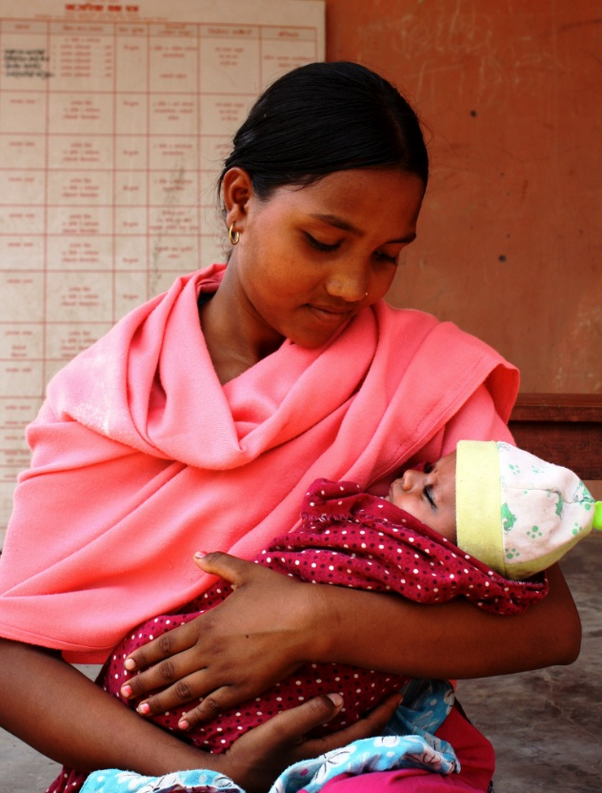
Cervical Cancer is a Silent Killer…
85%
Cases occur in developing countries
500,000
New cases per year
250,000
Deaths per year
Notes:
Cervical Cancer has been significantly addressed in the developed world through regular screening and timely interventions
Due to a lack of advanced healthcare infrastructure, Cervical cancer remains a large burden
> 500,000 new cases/year
> 250,000 deaths/year

Slide 3
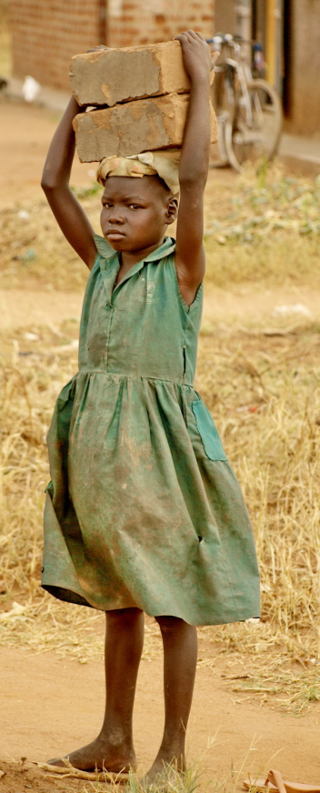
Families Suffer…
Productivity losses to the community
Loss of family backbone
Children drop out of school to go to work
Notes:
India $1.5 bil in productivity losses
Child drop out -> decrease in maternal and child well being in the next generation

Slide 4
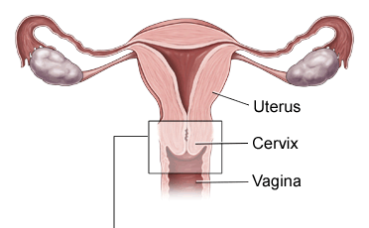
Development of Cervical Cancer
HPV Infection
Precancer
CANCER
10 yrs of asymptomatic progression
Notes:
Inadequate infrastructure prohibits the ability to widely screen and treat women in the developing world.
Jhpiego has developed low-cost screening method through the use of off-the-shelf vinegar to identify pre-cancerous lesions on the cervix, 5 cents/woman
However, there is a lack of appropriate technology to treat those who are tested positive, and therefore, countries in the developing world have been reluctant to role out large screening programs
- Say low risk of complications for cryo

Slide 5
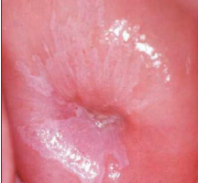
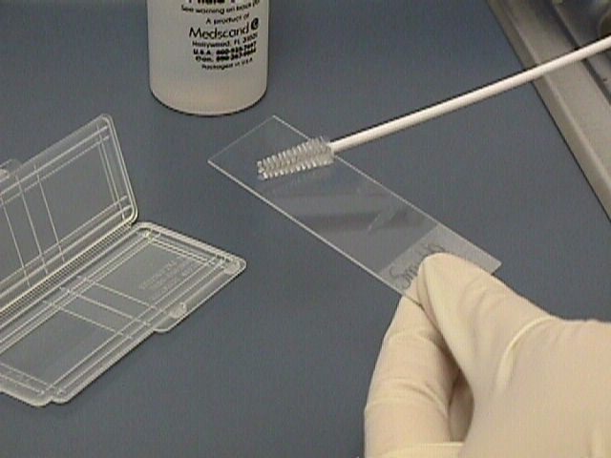
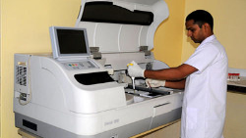
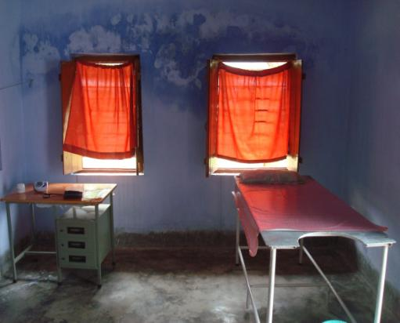

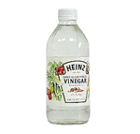
Screening
Pap Smear
Assessed by a pathologist
Requires pathology lab and follow-up
Sensitivity¹: 57% +/- 19%
Specificity¹: 94% +/- 2%
Vinegar / Acetic Acid
Lesions turn white
Instant diagnosis
5 cents / woman
Sensitivity¹: 79% +/- 6%
Specificity¹: 85% +/- 4%
Well-defined white lesions
There is a need for point-of-diagnosis treatment
1. Sankaranarayanan et al. “Pooled analysis of the accuracy of five cervical cancer screening tests assessed in eleven studies in Africa and India.” International Journal of Cancer. 2008; 123: 153-160
Notes:
Inadequate infrastructure prohibits the ability to widely screen and treat women in the developing world.
Jhpiego has developed low-cost screening method through the use of off-the-shelf vinegar to identify pre-cancerous lesions on the cervix, 5 cents/woman
However, there is a lack of appropriate technology to treat those who are tested positive, and therefore, countries in the developing world have been reluctant to role out large screening programs
- Say low risk of complications for cryo

Slide 6
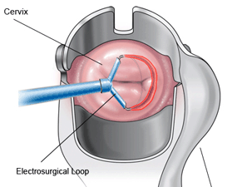
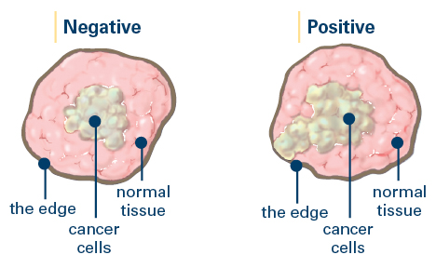
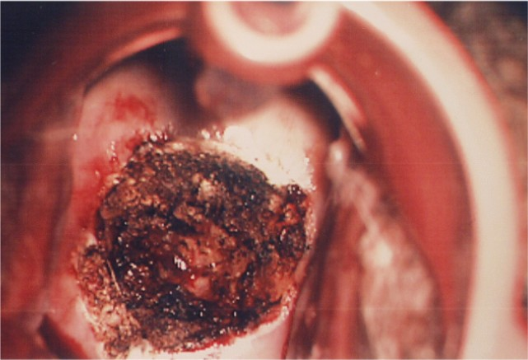
Solution: Electrical Excision
LEEP
  $300 / treatment
  Anesthesia
  Pathologist, skilled physicians and electricity
  Efficacy (treating CIN2)^{2:} 94%
Cervix after LEEP
Pathology required to make sure all pre-cancer was removed
2. Sankaranarayanan et al. “Effectiveness and safety of loop electrosurgical excision procedure in a low-resource setting.” International Journal of Gynecology and Obstetrics. 2008; 103: 105-110

Slide 7
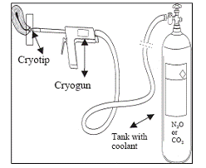

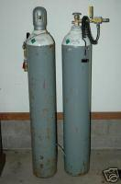
Solution: Cryoablation
Destruction through freezing
Uses available CO₂ gas
Efficacy (treating CIN2)³: 88%
Nurses and midwives
No anesthesia
Low complications
3. Alliance for Cervical Cancer Prevention (ACCP). “Effectiveness, safety, and acceptability of cryotherapy. A Systematic Literature Review.” Cervical Cancer Prevention Issues in Depth. 2003
Notes:
- Show how freezing works – gas to freeze

Slide 8
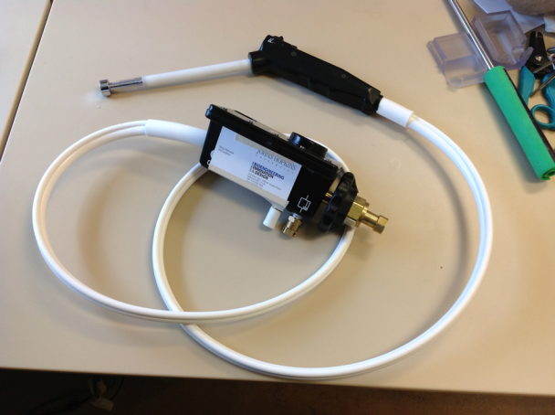
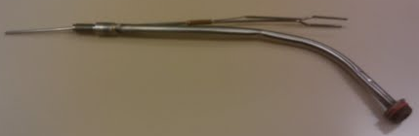
Current Inadequacies
Complexity of equipment causes failures and prohibits repair
$2,000
Cost per unit
10
Woman treated per 50lb of gas
$47
Cost per woman treated
Notes:
- Say: $47 – does not even include cost of facilities and personnel cost
Cost & Complexity of Current Cryotherapy Equipment prevents the massive scale-up of screen-and-treat programs that can significantly reduce the burden of cervical cancer in the developing world.

Slide 9
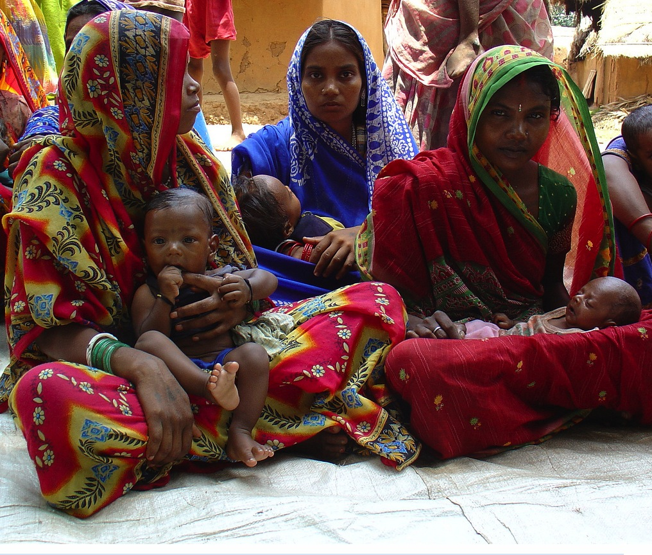
“There is a great need to improve cryotherapy methods, especially those based on CO₂, for treatment of cervical pre-cancer in resource-poor countries…”
-Rema P, et al.

Slide 10
Solution Landscaping
Peltiers?
  Car batteries do exist
  High current
Chemical Ablation?
  Somehow piggyback off of the vinegar binding to the precancerous cells
Make the CryoGun better?
  CO₂ is available
  Procedure is safe and proven effective
  Went to a manufacturer and saw first hand how inefficiently these devices were manufactured and how little it mattered to them

Slide 11
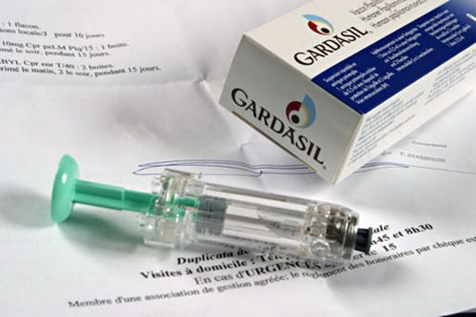
Even More Outside the Box
HPV vaccinations
  3 doses at $120/dose
  Ignore 2 generations of women

Slide 12


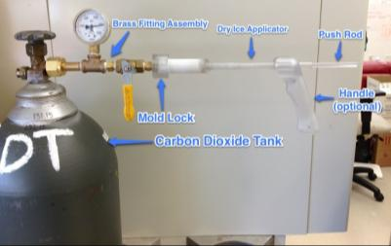
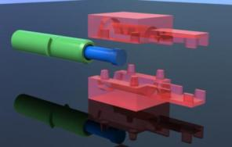
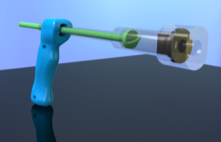
Ah Ha! Make Dry Ice!
How???
Initial Popsicle Design
Currently working on new ways of filling based on information from dry-ice making industry experts (modifying mold lock geometry)
First Machined Prototype
(for use in animal study)
Integrated Handle to Make it More Gun-like
First Push Pop Design

Slide 13
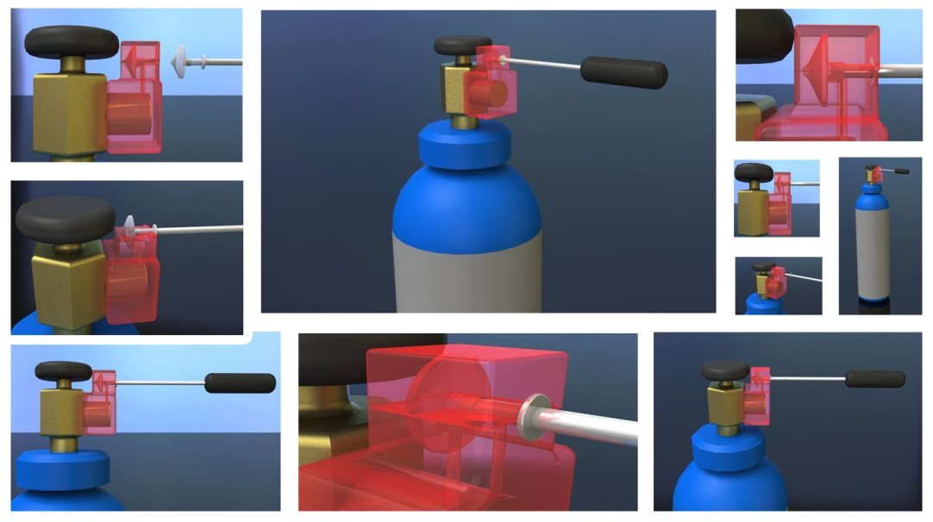
CryoPop
Popsicle Design

Slide 14
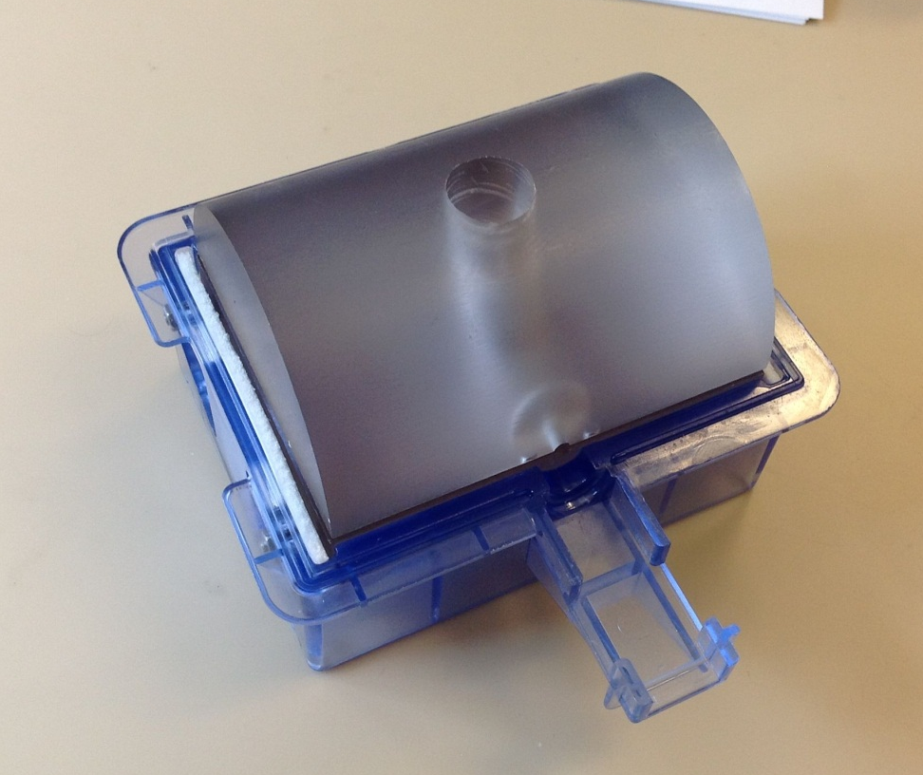
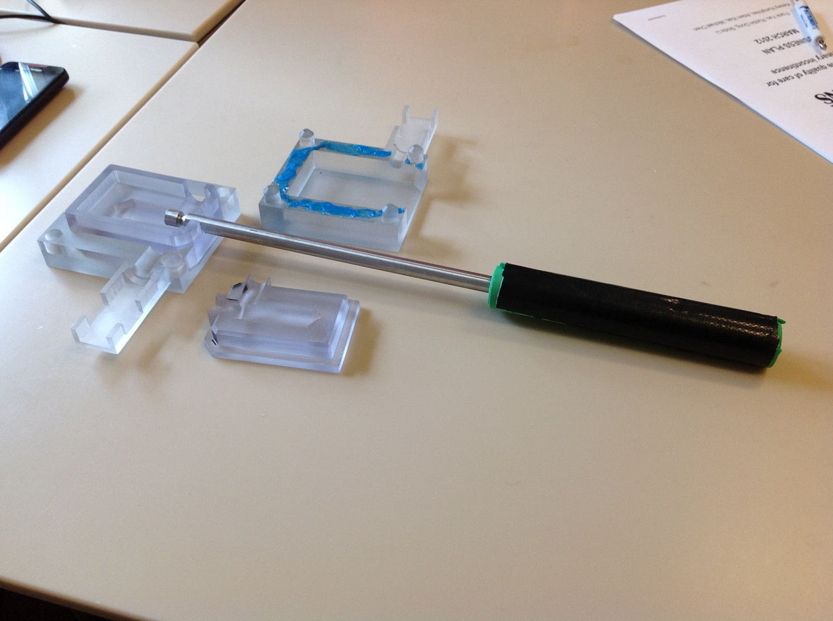
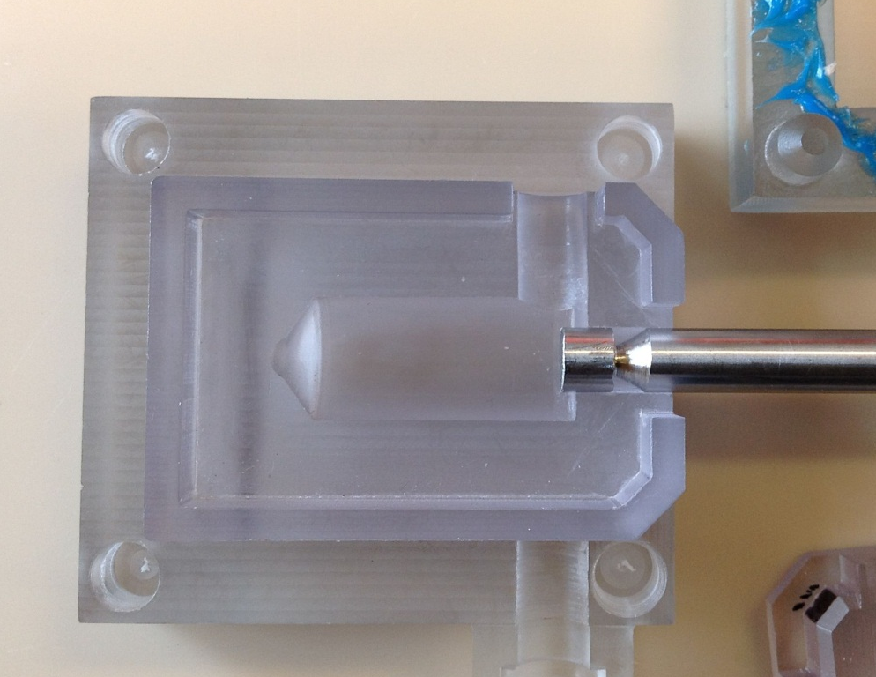
CryoPop
Popsicle Design

Slide 15

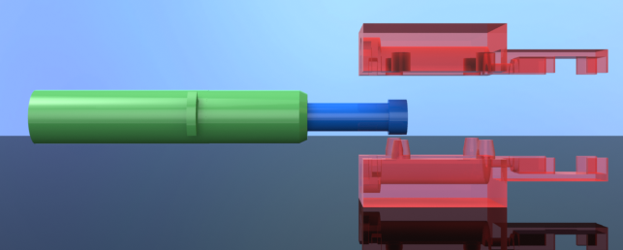
CryoPop
PushPop Design

Slide 16
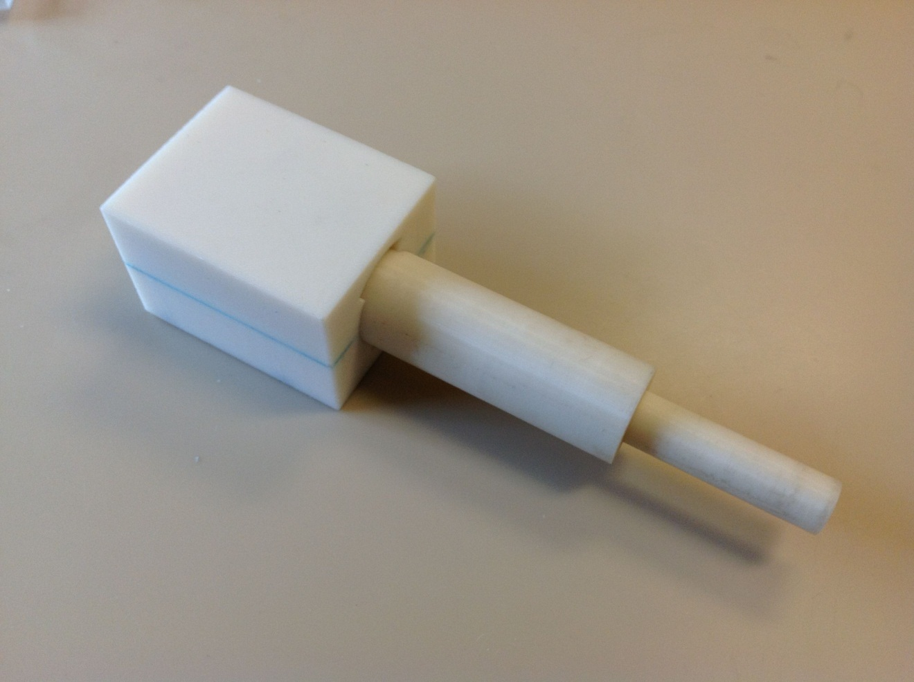
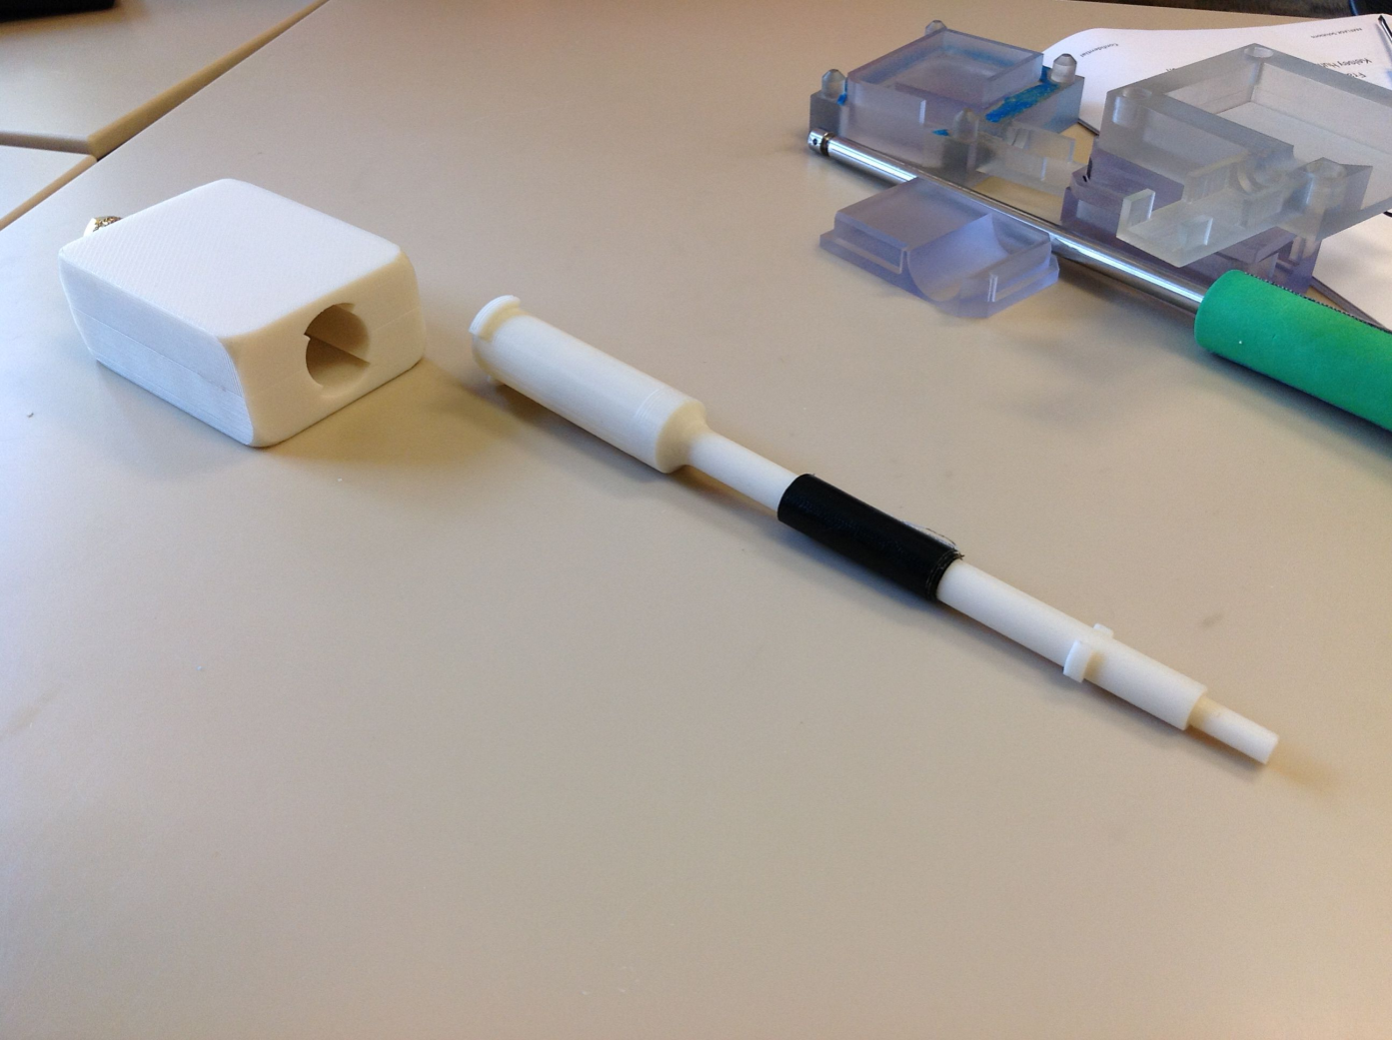
CryoPop
PushPop Design

Slide 17
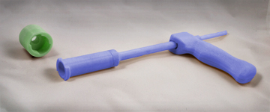
The CryoPopTM
30X
Increase in women treated per 50lb of gas
$1.95
Cost per woman treated
90%
Reduction in capital cost
Creates dry ice from CO₂
Dry ice “pop” freezes cervix
No complex parts
Does not change current treatment protocols
Notes:
More Effective and Reliable – appropriate for developing world!
- How do we create dry ice????
- This allows us to eliminate large 50lb tanks, which are a safety and logistical nightmare, and now use small 5lb tanks which opens up the possibility of portable screening n treatment

Slide 18
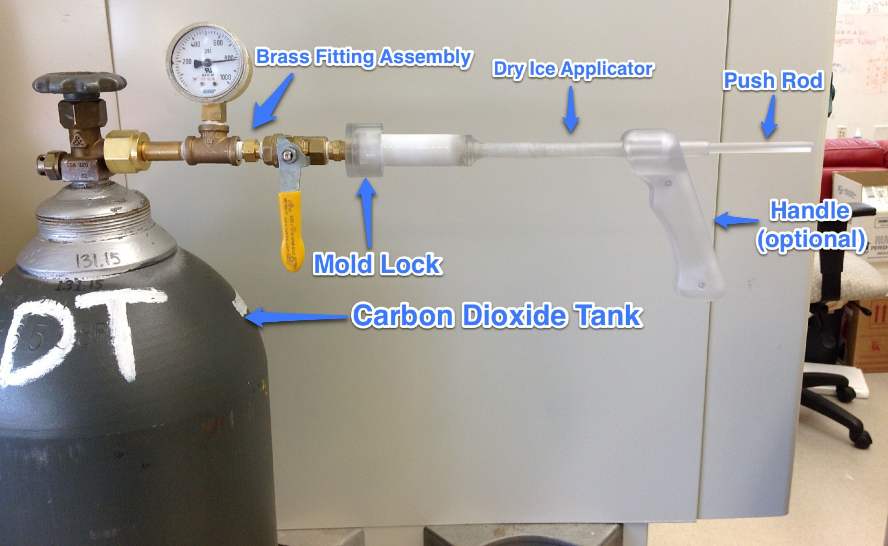
Recent Design

Slide 19

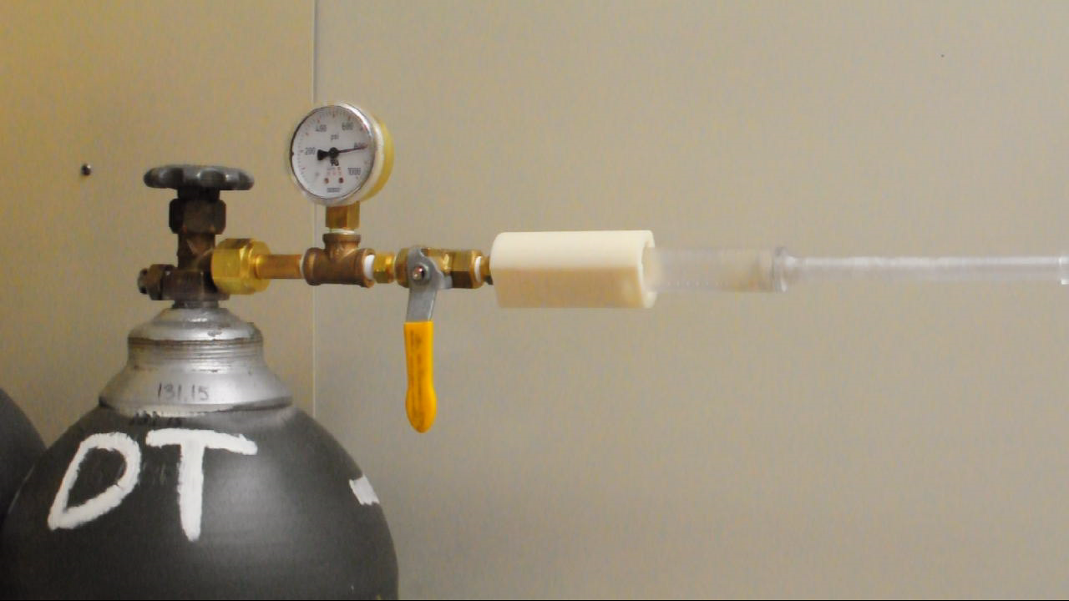
Demonstration…

Slide 20
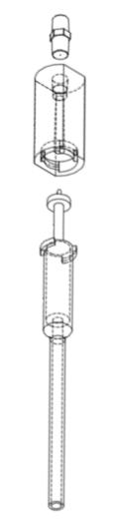
CryoPop Component Details
  Mold Lock:
    Controls Snow Formation
  Push Rod:
    Enables Nurse to safely push dry-ice against the cervix
  Dry Ice Applicator:
    Holds the dry ice and prevents accidental ablations
Notes:
- Replace picture**************

Slide 21
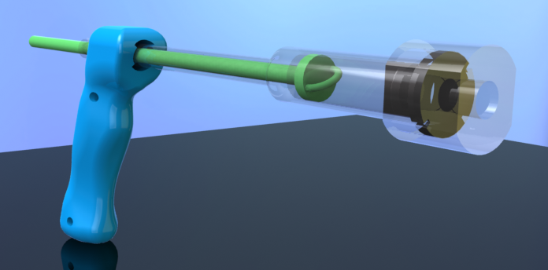
CryoPop Features
Low manufacturing cost ($19)
Biocompatible materials
Fits existing protocols
Notes:
Injection molded custom components
Standard brass fittings
Conservative cost of manufacturing $33
3 step process for HLD, decon, clean, sterilize or chlorine

Slide 22
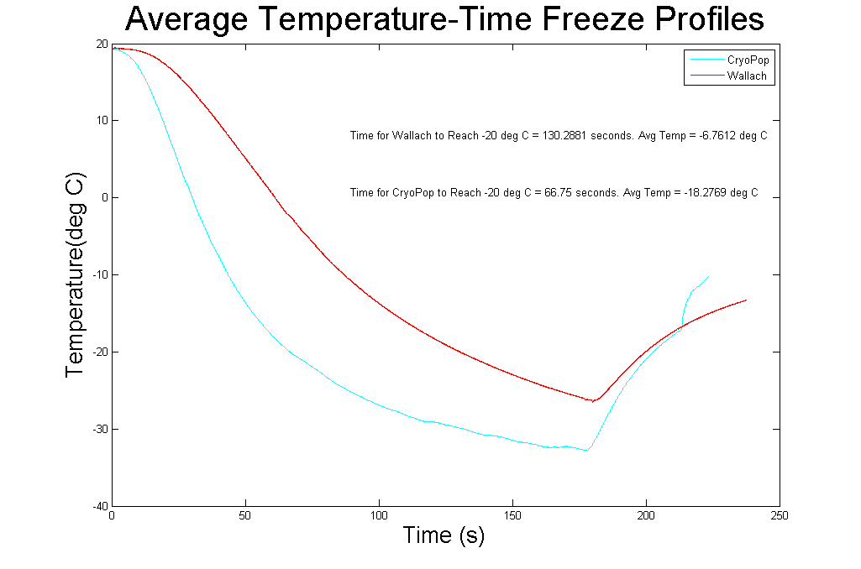
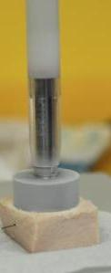
Bench Testing Complete
Cooler and Faster than current equipment
Notes:
- Quantify cooler & faster

Slide 23
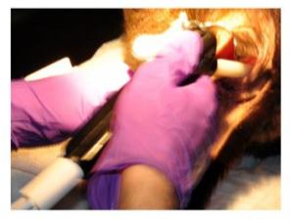
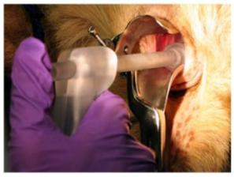
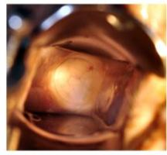
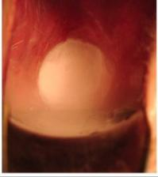
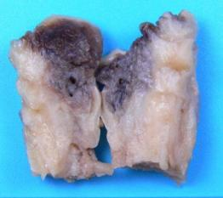
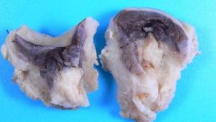
Animal Testing Phase 1
Further validated & refined design

Slide 24
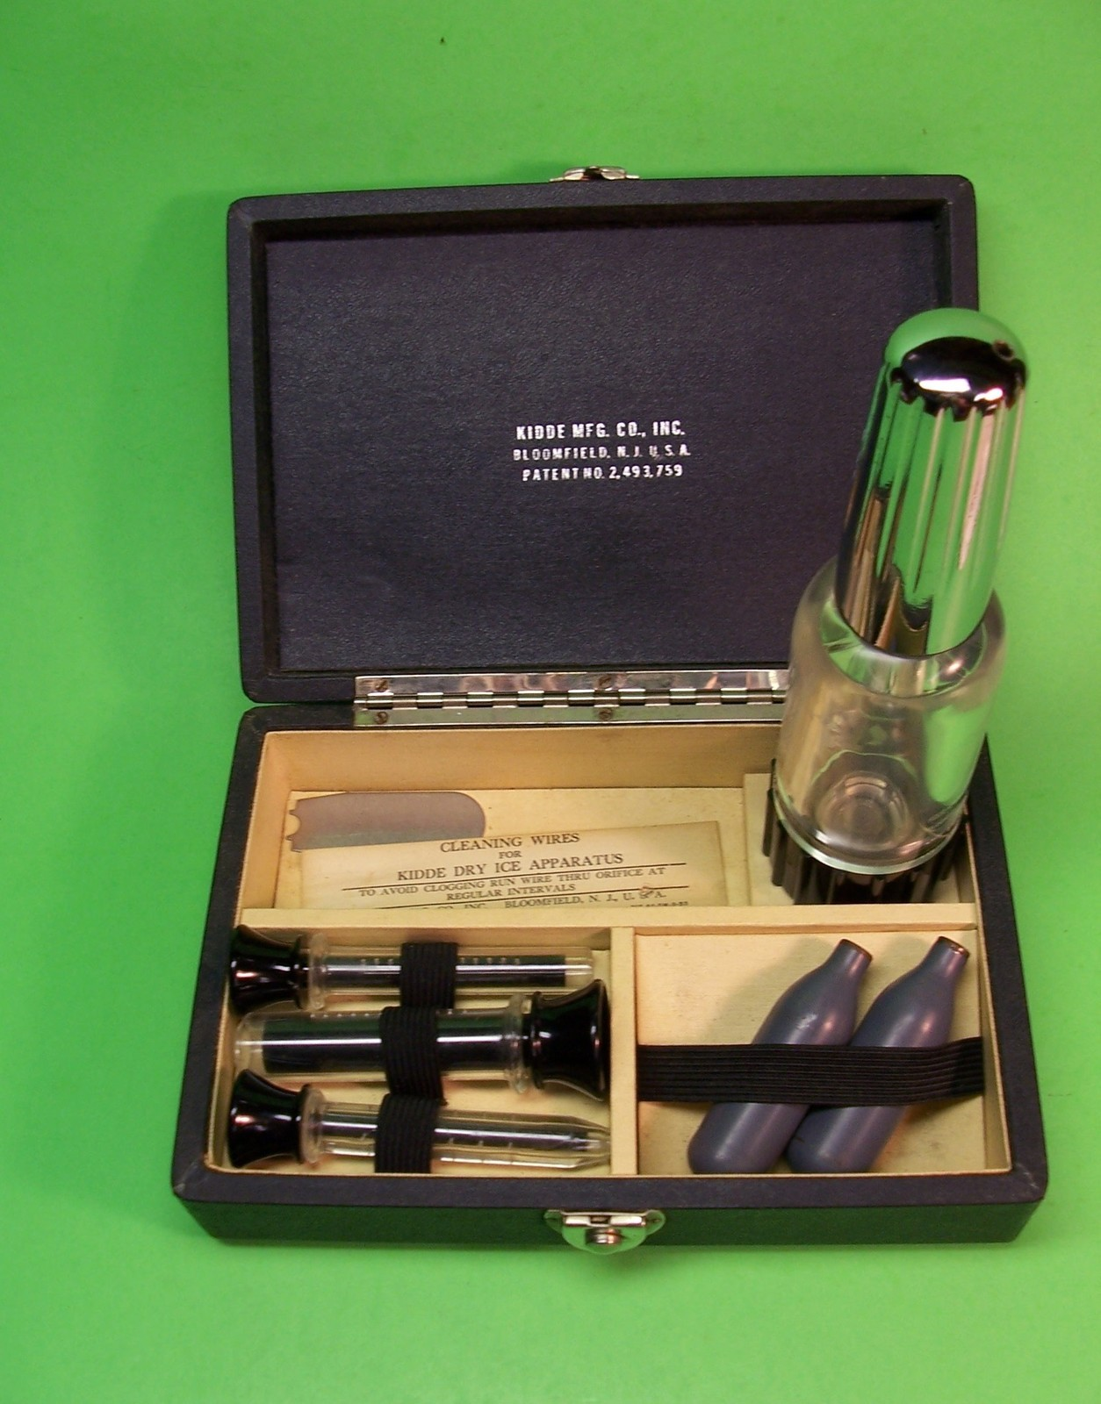
History Lesson
Dr. Leo Bobrow used the Kidde Dry Ice Applicator to treat cervicitis via cryoablation.
Idea: use small CO₂ cartridges.

Slide 25
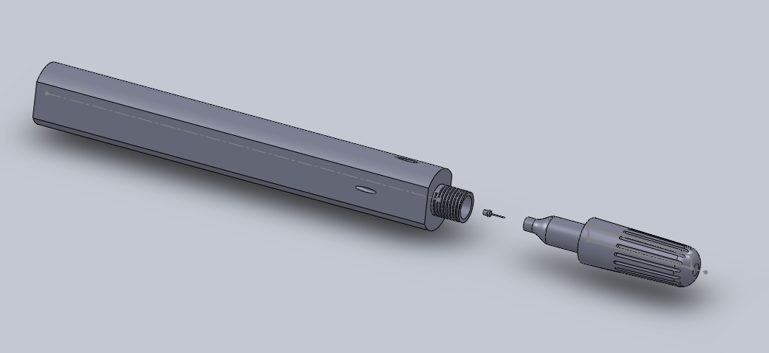
CryoPop
CO₂ Cartridges

Slide 26
Saving Costs, Expanding Treatment
120K
24X Additional patients treated with CryoPop
$47
X 5,000
$235,000
$225K
Saved per 5,000 patients treated

Slide 27
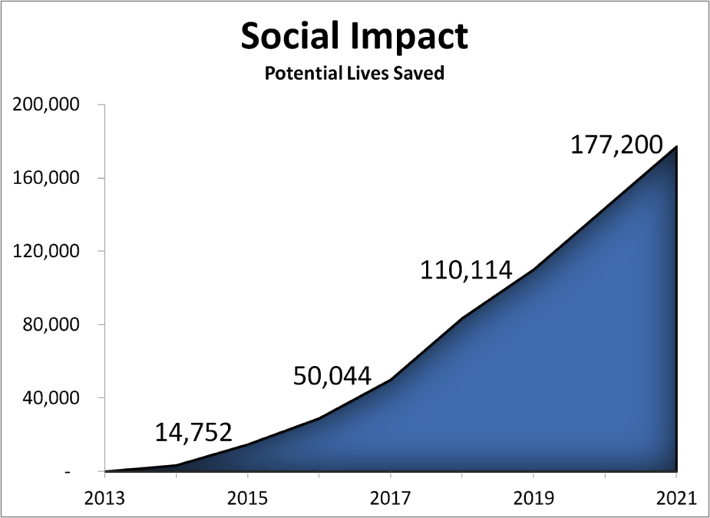
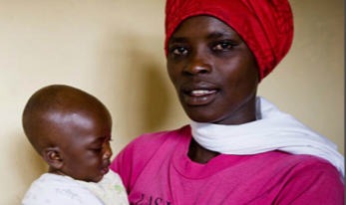
Delivering Meaningful Impact
Potential to save 50,000 lives within 5 years

Slide 28
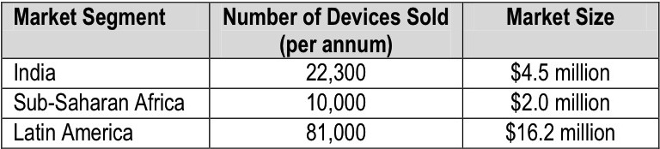
Target market
Growth rate of cervical cancer deaths 3.5% (every year)
Competitors not active in this market – potential to take the market
Notes:
Estimated on number of primary health centers (PHC), assuming selling volume of 3 Cryopops every 3 years
- Total of over 20 million

Slide 29

“Strengthens the capacity of countries to save the lives of women and families today”
High-quality healthcare in remote and low-resource settings
Women’s health
Implemented cervical cancer screening (Vinegar)
  Adoption, training and distribution

Slide 30

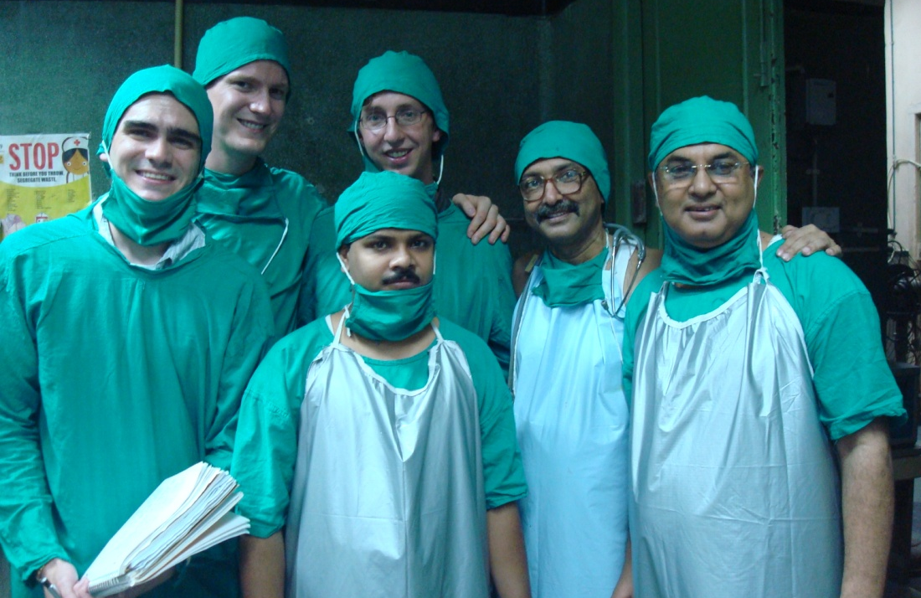
Product-Market Fit
Jhpiego Partnership
  Continuous development feedback
  Access to customer
9+ week Clinical Immersion
  Customer needs validation
  Critical success factors
Notes:
-3+ weeks in rural india and nepal, gathering user needs

Slide 31



Smooth Regulatory Pathway
801(e)(1) Pathway
Export only
Class II
No regulatory submission required
European CE Mark
Standard of quality & safety
Notes:
s

Slide 32



Barriers to Entry
IP
Limited IP protection in many developing countries
Purchasing Influences
NGOs and WHO have strong influence on MOH purchase decisions
Subtle Trade Secrets
Ours will be the safest and most effective device on the market
Notes:
m

Slide 33
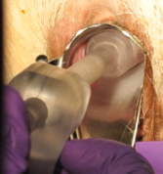
Milestones
Already Accomplished
Clinical Immersion | Aug 2011
Proof-of-concept | Nov 2011
Bench Testing | Jan 2012
Animal Testing | Feb 2012
$20,000
Grant Funding
2011 | 2012 | 2013 | 2014 | 2015

Slide 34
Milestones
Phase 1
Development Freeze | Aug 2012
R&D Manufacturing Tooling | Oct 2012
IRB Filing | Dec 2012
Human Case Study (US) | Feb 2013
Start Human Clinical (Kenya) | May 2013
Immediate Milestones
2011 | 2012 | 2013 | 2014 | 2015

Slide 35
Milestones
Phase 2
Large-Scale Manufacturing (Taiwan) | May 2014
Complete Human Clinical (Kenya) | Jun 2014
Platform Development | Feb 2015
Long-term Milestones
2011 | 2012 | 2013 | 2014 | 2015

Slide 36

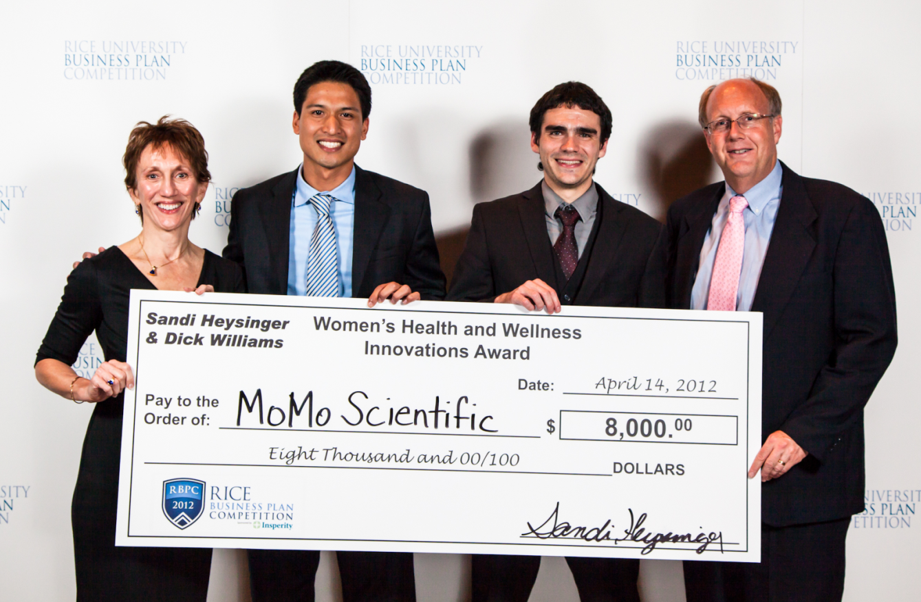


Accomplishments
7th Place (tie) out of 1,600
Women’s Health and Wellness Innovations Award
1st Place, Social Venture
NCIIA Phase 1 VentureLabs
Grant Recipient ($5,000)
Semi-Finalist (ongoing)
BMEidea
Finalist – Top 3

Slide 37
Thank You!!!
Ricky Lu, MD – Jhpiego
Harshad Sanghvi , MD– Jhpiego
Lawrence Aronhime, MBA - JHU
Soumyadipta Acharya, MD, PhD – JHU
Youseph Yazdi, PhD – JHU
Marybeth Camerer – JHU
Matt Fifer - JHU
Kristy Peterson - JHU
Dawn Ruben – JHMI
Cory Brayton, PhD – JHMI

Slide 38
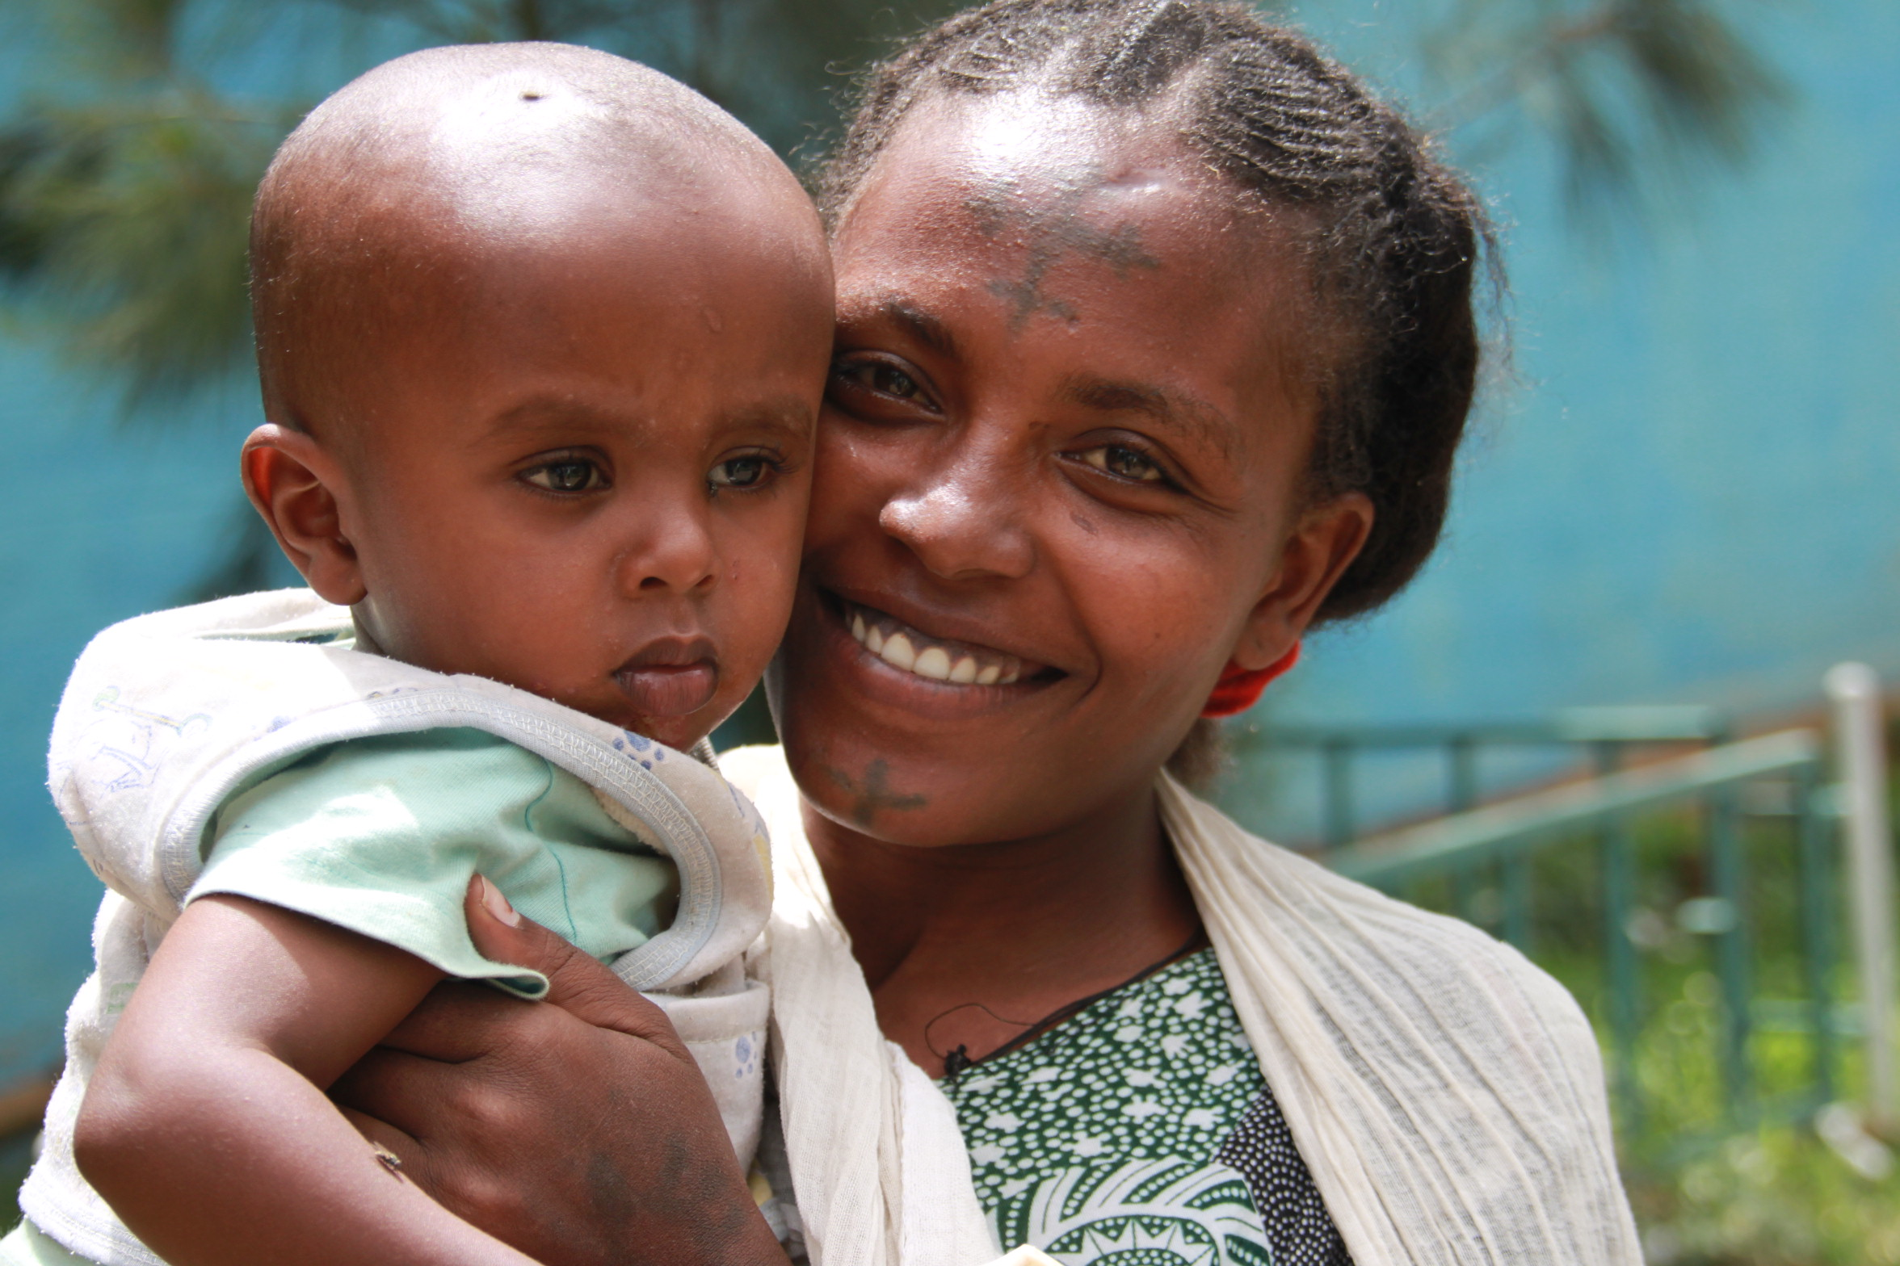
Conclusion
MSCI has identified a large clinical problem
  250,000 deaths per year
CryoPop is the appropriate solution
Management, partnerships and advisory board will drive the company to success
Notes:
but what I want to leave you with is the thought that cervical cancer is widely eradicated in developed countires such as the US, and there is absolutely no reason why women should be still suffering and dying from this preventable disease. If you share the same thoughts and visions of this statement, I hope you will join Momo Scientific in our quest for the eradication cervical cancer.

